Slide 1
Parent/Carer Information Evening Y10
20th September 2023
Notes:
Welcome to you all – and thanks for coming.
Introduction to the team for tonight:
Mrs Edge – as HoY
Mrs Harris and Mr Uglow - SLT links to support Y10
Mr Giblin – as Curriculum leader

Slide 2
The Parent Pack
How to support your child
Academic subject overview
PD overview
GCSE Factsheet page
Extra-curricular offer
Key dates for Y10
Notes pages

Slide 3
Aims
How we can support each other to give your child the best chance of success in Y10, and ultimately in Y11
What’s ahead – what’s involved in this really important, foundation KS4 year?

Slide 4
What do we want for our students?
• Are safe and feel safe
• Happy
• Feel supported
• Included – belong just as much as anyone else
• Pushed to achieve the best in all subjects
• Help students to develop into wonderful human beings
• On the path to become the very best version of themselves

Slide 5
Our Number 1 Priority
LEARNING

Slide 6
How do we tackle our number 1 priority?
Behaviour
Uniform
Attendance
Punctuality
Interaction with adults & peers
Rewards
Notes:
High expectations with our standards – of everything.
Conduct and presentation, organisation, interactions, engagement.
They will be pushed and challenged – but credit given where it is due.

Slide 7
Rewards
Notes:
New rewards system introduced last year – this year it includes our 5 core values.
Respect, love, resilience, being of service, integrity.

Slide 8
Your Support makes a HUGE difference…
Parental support is more important in determining a child’s academic success than other factors outside of secondary school
More than KS2 outcomes
More than social class
Only by working together can we maximise the life chances of our children
We thank you in advance for your support over the next two years
Notes:
We've talked about our role/input as a school – so what can you do as a parent? See next slides….

Slide 9
The GCSE Exams in Summer 2025
Students will sit in excess of 20 different exams during a 4-week period either side of the May Half Term break in 2025
Unlike 2022, there will be no content adjustment or adaptations
Notes:
Students have a lot of demands coming their way.
The 'new' GCSE has far more in terms of examination time and content.

Slide 10
The GCSE Exams in Summer 2025
Most will gain 9 GCSE / Voc qualifications
4 exams in English Language & English Lit
3 exams in Maths
6 exams in Science
3 exams in RE
3 exams in History or 3 in Geography
Plus more exams in their other option subjects (how many depends on what they have selected)
For all students they will be sitting over 20 different exams in a 4-week period in May / June of 2025

Slide 11
Your role in supporting their GCSE Outcomes
The GCSE results from the summer reinforced a key fact – that the more pupils attend school, the better their outcomes
Please do everything you can to ensure your child attends school every day
If pupils are not in, we cannot help them
Please avoid appointments, meetings etc during the school day
Notes:
One of the most important things you can do to support your child through this year is ensure they are in school every day. A cold is not a reason to stay off school. You need to be cruel to be kind to help your child maximaise the opportunity that they have. A lesson missed is so difficult to catch up. Just one day absent means 5 hours of missed learning, that is a lot to expect your child to catch up. This year group last year had the lowest attendance to school out of any other year group. This has to change in order for your child to become the best version of themselves. If they are not in school we cannot help them. Any appointments during the day that are unavoidble send your child into school before and after the appointment.

Slide 12
Attendance
If a pupil has an overall attendance of 95%, this may sound good, yet it actually means the pupil will have missed 9.5 days of lessons, which is nearly 50 hours of input from their class teachers that they will never get back – plus lost opportunities for intervention and support.
Notes:
The graph speaks for itself – national picture and shows the outcomes of thousands of students who have varying rates of attendance
There is a direct correlation between the number of days you come to school and the final outcome you’re likely to get in all subjects
We’ll be keeping a very close eye on this and be on to you about your attendance if it is a concern. 95% for the year is equal to 10 days of absence…
that is 2 full school weeks of missed learning for the year: = 10 x English lessons & 8 x Maths lessons (16hrs)
90% for the year is equal to 1 day off every 2 weeks… that is over 3 full school weeks of missed learning for the year: = 13/14 x English lessons & 13/14 Maths lessons (26-28hrs)

Slide 13
Punctuality
Pupils should be in school, ready for the day by 8:45am.
Once the second bell has gone at 8:50am… they are LATE!
Registration and form time is:
The legal school register for the morning
When a Form Tutor can check in with a student
When a form tutor can have some pastoral time with the whole form
When important messages about the school day are shared
When HoYs can find students to check in with them
When Pastoral support can be provided
When form reading happens to improve literacy
Notes:
Our start time has changed, we expected pupils to be in by 8.45 once the second bell has gone they are late.
Being late to school reduces learning time
10 minutes late a day equals to almost a whole hour of for time missed each week, over the school year this equates to 2 whole weeks
Your child will miss valuable Important information relevant for Y11s
Careers advice and information about colleges and apprenticeships
Revision guidance
Support with reading if it is needed
Some subject specific interventions
Arriving late to their form or lesson causes disruption to the whole class as well as to your child
Children are often very embarrassed and upset at coming into class late

Slide 14
How else can you support your child?
Patience, Love, Care
Support, Guidance, Organisation
Independent Study
Notes:
So, you've got them into school on time, dressed smartly in their uniform – what else can you do to support?
Remember that this will be stressful for them, it will be tiring, nerves will be on edge. They need your love, patience and care over this time in KS4 maybe more than any other.
Help them to be Is this the same time as they go to sleep? Or are they up late watching films, on their phone or playing on the games console?
There is a direct link between the amount of good quality sleep a child has and their academic success.
Without good sleep, mood, concentration, learning and memory are all affected – it leaves children in no fit state to fully engage with the learning opportunities on offer that day – they are here in body but not in spirit!
Time eaters include: TV, mobile phone, Facebook, Snapchat, WhatsApp, Play Station, Xbox, Netflix – they might even offer to tidy their room or do the washing up!!
2-3 hours of additional study per day =
14-21 hours per week
THIS INCLUDES HOMEWORK!

Slide 15
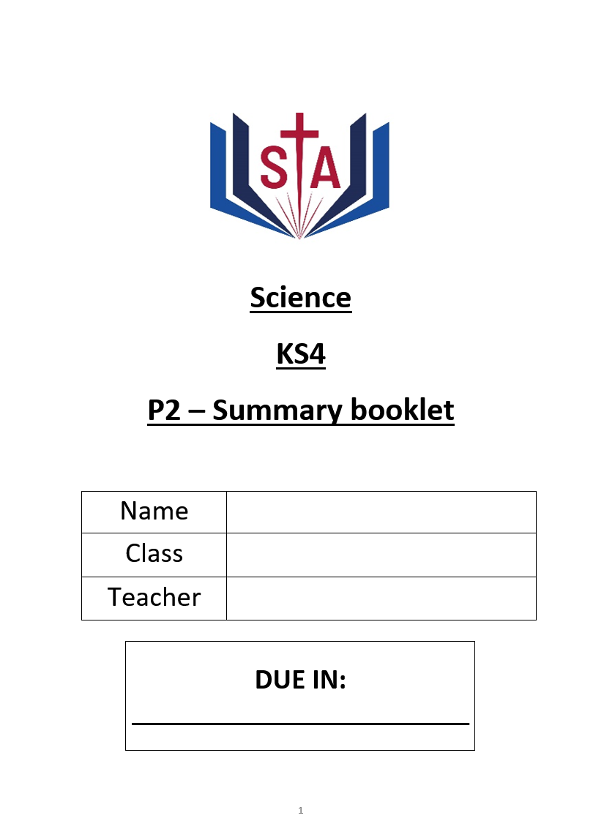
Year 10 homework / revision
Purpose: Help students know more, remember more and be able to do more.
This makes lessons easier, tests easier, and exams easier.
Helps students achieve higher, reach their potential and access their college courses.
Supports them to become independent and resilient.

Slide 16
Year 10 homework / revision
Purpose: Help students know more, remember more and be able to do more.
Revision guides and knowledge organisers provide the knowledge.
Homework booklets provide the questions and space to write answers.

Slide 17
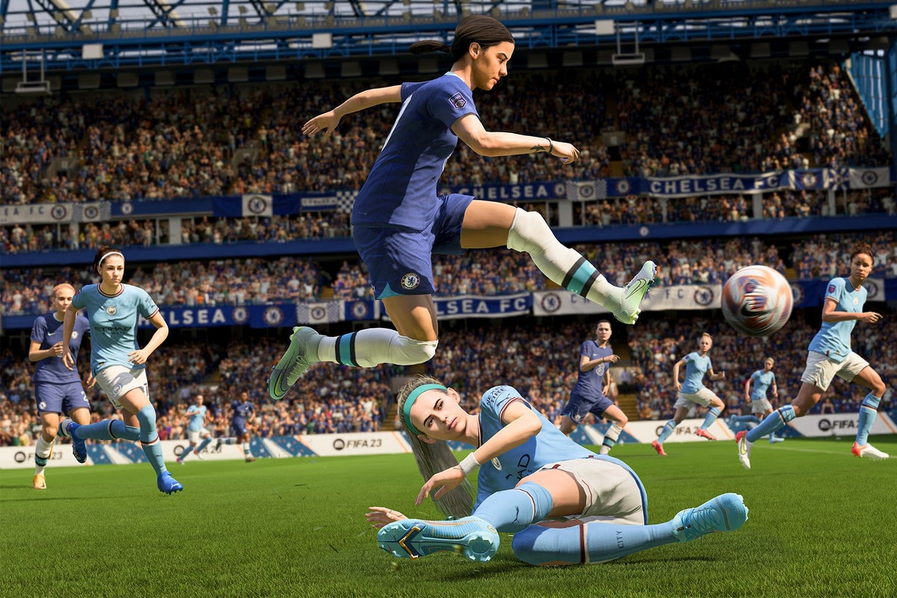
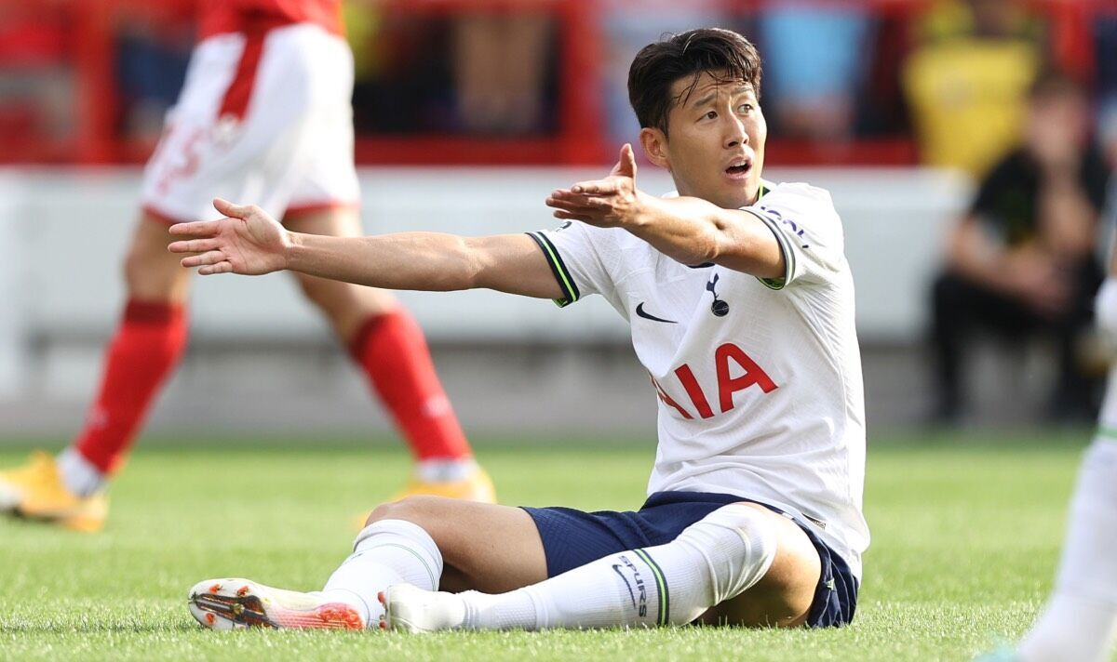
Why not just use online revision platforms?
Not all pupils have access to devices / WiFi at home.
Having to use a device means distractions from the device.
Devices can be confiscated, which means missed homework and detentions.
Exams are written.

Slide 18
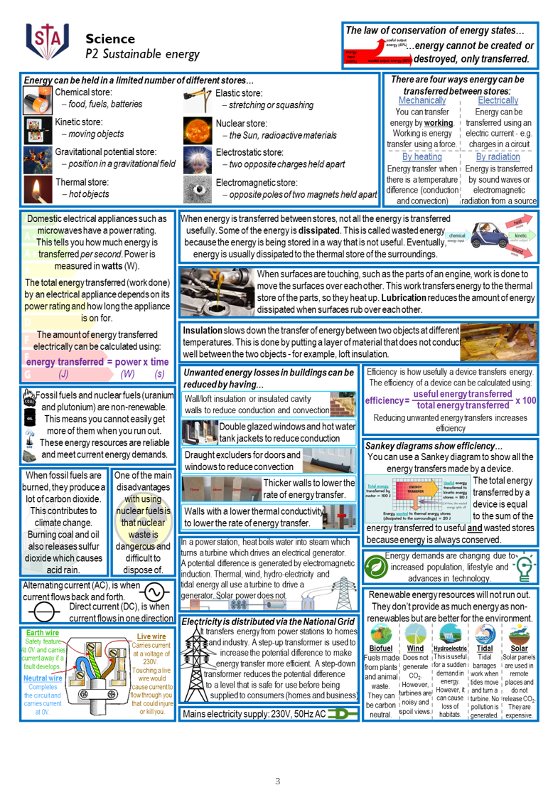
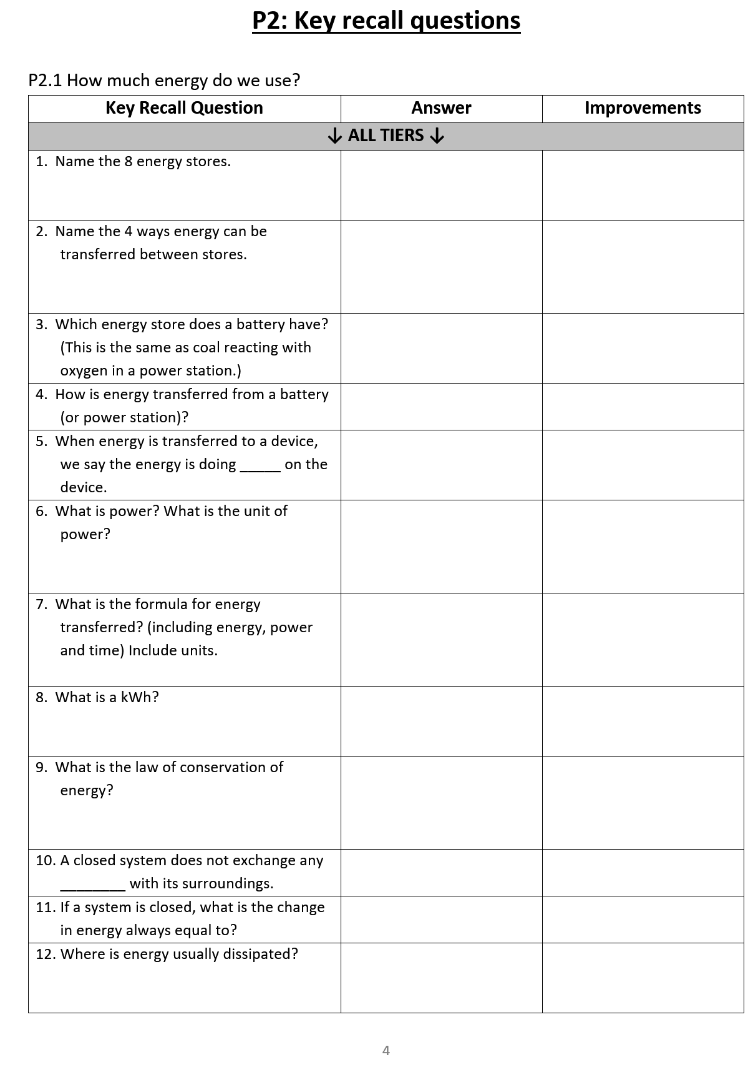
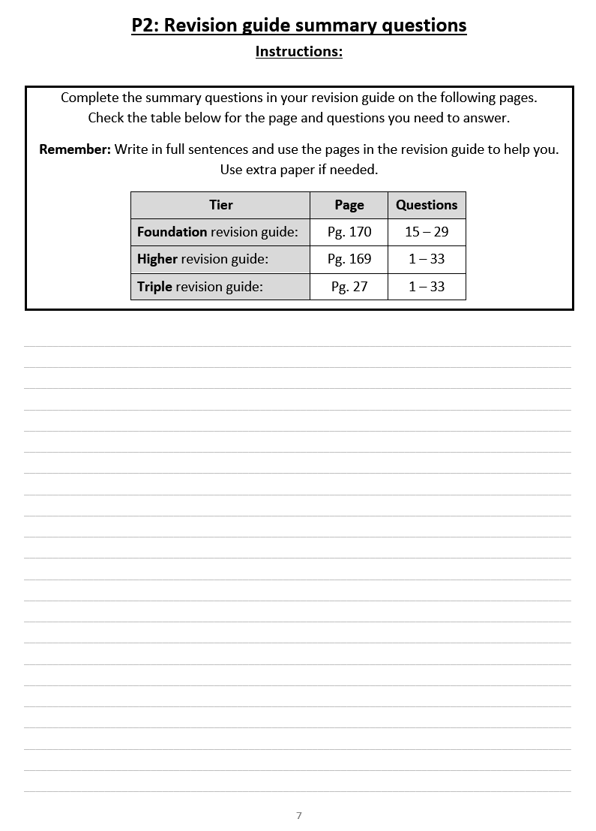
Year 10 homework / revision
Tried, tested and PROVEN TO WORK

Slide 19
Year 10 homework / revision

Slide 20
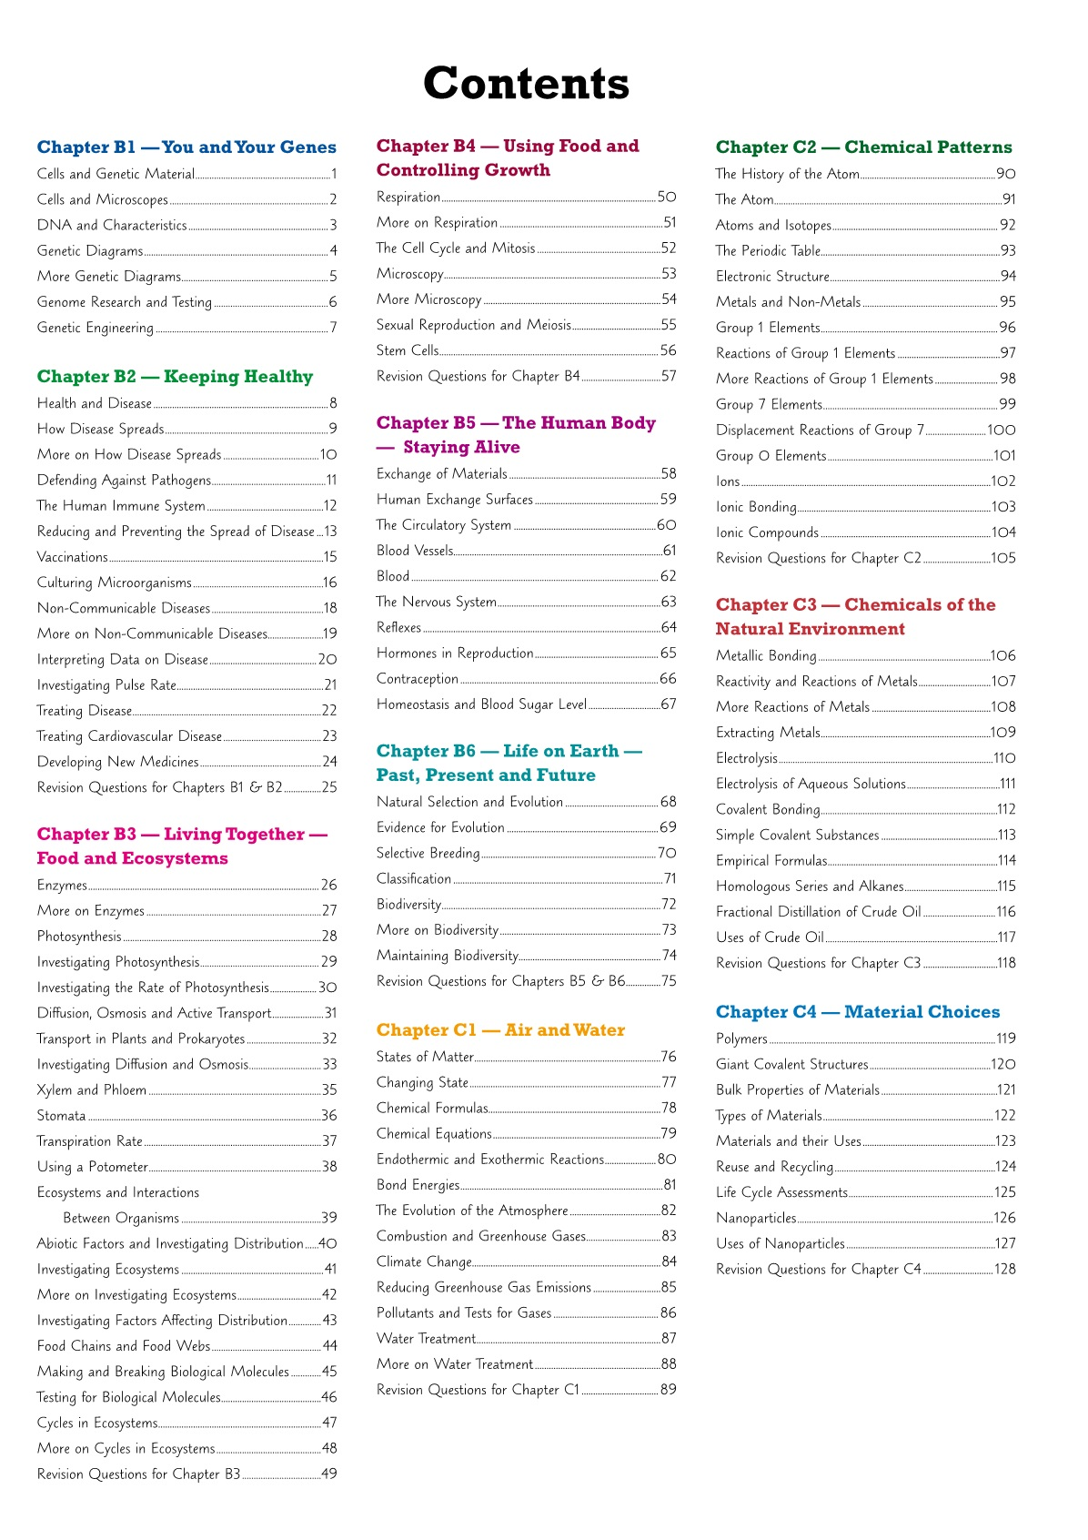
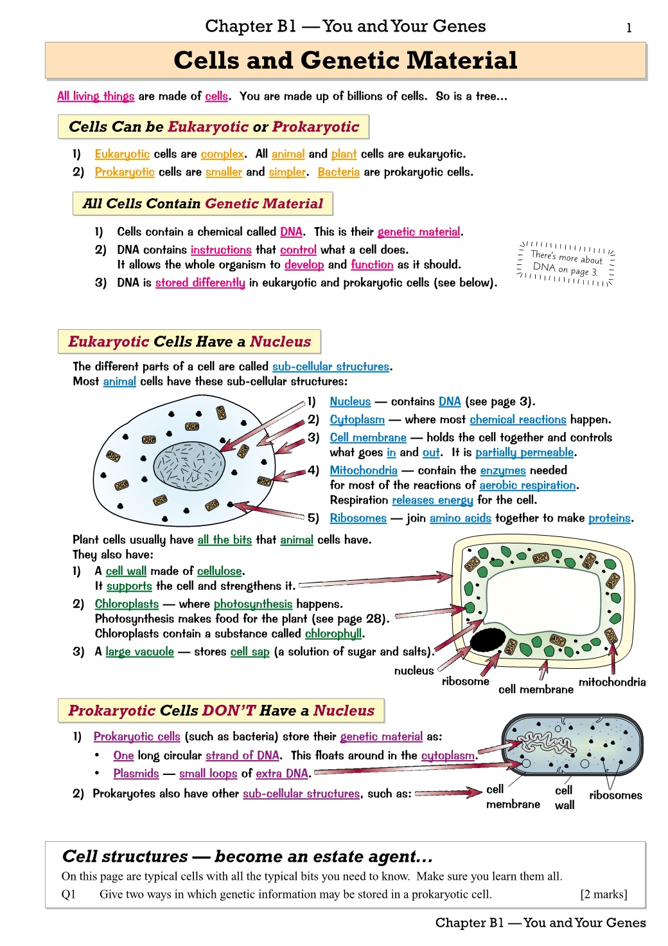
Year 10 homework / revision
Science example, but all subjects will be doing this (or something very similar)

Slide 21
Year 10 homework / revision

Slide 22
Year 10 homework / revision

Slide 23
Year 10 homework / revision
Tried, tested and PROVEN TO WORK
Students will use revision guides in Year 11 too

Slide 24
Year 10 homework / revision
Students have been given an A4 plastic folder to look after their homework booklets
Homework club is available period 6, Mon-Thurs in CR3.
Quiet environment with access to computers.
Stay organised and complete homework on time
Please ensure they have a big enough bag

Slide 25
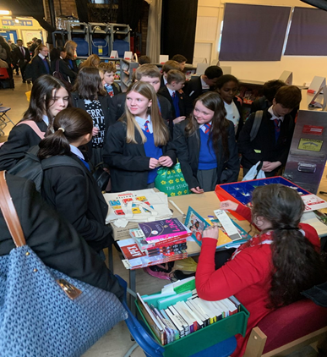
Get Ready to Read!
St Antony's is a reading school and we want all pupils to get involved!
Notes:
Reading! Culture of reading being promoted at school.
This is invaluable for accessing academic texts and tests but also for relaxation.
AND it helps with GCSE outcomes – more on that shortly.

Slide 26
Reading Initiatives 2023/2024
As we develop our new library and reading culture, we want pupils to have a say and to lead the way
More Reading Ambassadors will be recruited in September – a chance for pupils to lead!
We have spent thousands of pounds on new books!
We test and monitor reading ages of all pupils, with more frequent testing for developing readers and those being supported by tutors
We support our developing readers with reading intervention groups 2-3 mornings a week, either in form, or in a small group with a member of staff
Curriculum Leaders are adapting their planning to ensure that reading materials are linked to pupils’ learning and specific subject terminology is highlighted
All teachers are expected to support pupils’ literacy and interest in reading, through recommendations, guidance and support with literacy across all subjects
The English Department have created Key Stage 3 and 4 Reading journeys that complement the learning in curriculum time
Notes:
So critical do we see reading and building literacy competence, that we've been strategic in our actions and planning of reading.
See here the focus on Reading Ambassadors and the library
Also on the monitoring and intervention to support reading – Y10 have now all had their testing completed in an English lesson
Curriculum planning

Slide 27
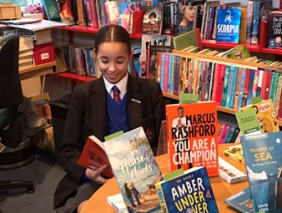
Benefits of Reading
Children who read books often and more than once a week, at 16 gain higher results in maths, vocabulary and spelling tests than those who read less regularly
16-year-olds who choose to read books for pleasure outside of school are more likely to secure managerial or professional jobs later in life

Slide 28
The Year 10 Curriculum
Subject | Autumn 1 | Autumn 2 | Spring 1 | Spring 2 | Summer 1 | Summer 2
Art, Craft and Design Subjects | Project 1: My Surroundings During this term, pupils will undertake research to form the basis of a personalised project on ‘My Surroundings’. They will use artist references and mixed media as a basis for the required portfolio of work. |  | Project 1: My Surroundings Pupils will continue to develop mixed media imagery in response to research and create a final sustained outcome for the portfolio. |  | Major Project Pupils will begin work on the major project. This will take them through to Christmas of Y11. The project will include research, artist references and mixed media.
Business | Business activity -Introduction to business. -Nature of business activity -Supply of goods and services -Enterprise | Business activity -Legal forms of a business -Business goals -Business growth | Influence on business -External factors and business faces -Technology -Economics | Influence on business -Environment -Ethics -Globalisation law | Business operations -How businesses use resources to produce goods and services. -Production | Business operations -Quality sales customer service
Computer Science | -System Architecture -Memory & Storage -Python Programming: ongoing skills | -Memory & Storage -Python Programming: ongoing skills | -Computer networks connections and protocols -Python Programming: ongoing skills | -Python Programming: ongoing skills | -Systems software -Python Programming: ongoing skills | -Ethical legal cultural -Python Programming: ongoing skills
English | -Explorations in creative reading and writing | -‘An Inspector Calls’ by JB Priestley (faster reading) & deeper study | -‘Macbeth’ by William Shakespeare -Creative writing | -‘The Strange Case of Dr Jekyll and Mr Hyde’ & using the text for Lang Paper 1 | -Poetry: ‘Power and Conflict’ -Spoken Language Assessment -Flashback Fridays on ‘An Inspector Calls’
French | Theme 1: Identity and Culture Topic 1: Me, my family and friends -Relationships with family and friends -Marriage/partnerships | Theme 1: Identity and Culture Topic 3: Free-time activities -Music -Cinema and TV Food and eating out -Sport | Theme 1: Identity and Culture Topic 2: Technology and everyday life -Social media -Mobile technology | Theme 1: Identity and Culture Topic 4 -Customs and festivals in French-speaking countries | Theme 2: Local, national, and international areas of interest Topic 1 -Home, town, neighbourhood and region | Theme 2: Local, national and international areas of interest Topic 2: Social issues -Charity/voluntary work -Healthy/unhealthy living
Food (Hospitality & Catering Technical Award) | Unit 1 - Hospitality and employment roles. Food preparation skills and cooking | Unit 1 – The economy and Health & Safety. Food preparation skills and cooking | Unit 1 – Manual handling, HACCP & causes of illness and the role of the EHO. Food preparation skills and cooking | Unit 1 – Food preparation techniques, garnishes & decoration. Food preparation skills and cooking | Unit 2 – Impact of cooking, nutritional needs, food choice and planning documentation. Prep skills and cooking | Unit 2 – Practise assessment based on a prior examined theme. Food preparation skills and cooking

Slide 29
The Year 10 Curriculum - continued
Subject | Autumn 1 | Autumn 2 | Spring 1 | Spring 2 | Summer 1 | Summer 2
Geography | -Coasts and ecosystems | -Ecosystems under threat Desertification | -Global cities | -Urban and rural environments | -Rivers | -Rivers -Human fieldwork
History | Medicine through time -This unit incorporates medicine from the ancient world through to the NHS -The unit includes a case study of medicine in World War |  | Weimar and Nazi Germany -The impact of World War I -The rise of Hitler |  | Elizabeth I | Elizabeth I
Maths | -Congruence, similarity and enlargement -Trigonometry | -Representing solutions of equations and inequalities -Simultaneous equations -Angles and bearings | -Working with circles -Vectors -Ratios and fractions | -Percentages and interest -Probability | -Collecting, representing and interpreting data -Non-calculator methods | -Types nof number and sequences -Indices and roots -Manipulating expressions
Music | Forms and Devices -Introduction to performance | Popular Music -Continuation of performance -Introduction to composition | Music for Ensemble -Intro to ensemble performance | Film Music | -Revisit earlier modules -Mock performance assessment -Free criteria composition
PE Sports Science | Applying the principles of training. Fitness and how it affects skill performance. | Applying the principles of training. Principles of training in sport. | Applying the principles of training. Organising and planning a fitness programme. | Applying the principles of training. Evaluate own performance. | Nutrition and Sports Performance. Nutrients for a healthy plan. | Applying the principles of training. Applying different dietary requirements.
PE GCSE | Skeletal System. Muscular system. | Movement analysis. Cardiovascular and Respiratory system. | Effects of exercise. Components of fitness. | Principles of training. Prevention of injury. | Coursework completion. | Coursework completion.
RE | Judaism - Beliefs and teachings -The nature of God -The Messiah -The covenant with Abraham -The covenant with Moses -The mitzvot -Life after death | Judaism - Practices -The synagogue -Worship -Rites of passage e.g. Bar & Bat Mitzvah -Festivals | Origins and Meanings -Origins of the universe -The value of human life -The environment -Catholic Social Teaching |  | Good and Evil -The Trinity -The Incarnation -The origin of evil -Goodness -Responses to evil -Jesus as a moral authority -Sculptures and statues -Pilgrimage -The Rosary
Science (Triple cover topics in greater depth) | -Electrical current & power -Space physics -Genetics | -Chemical bonding -Waves and the EM spectrum | -Evolution -Acids and alkalis | -Forces and their effects -Plants | -The Earth’s atmosphere -The particle model | -Radioactivity -The endocrine system

Slide 30
Reports home to You
The following table indicates the general content of this year's reports:
December Interim Report​ | April Interim Report | July Full report​
Attitude to learning score​ Homework score​ Attendance​ Punctuality​ Reward points​ Behaviour points​ Current working grade in each subject​ | Attitude to learning score​ Homework score​ Attendance​ Punctuality​ Reward points​ Behaviour points​ Current working grade in each subject​ ​ | Attitude to learning score​ Homework score​ Attendance​ Punctuality​ Reward points​ Behaviour points​ Current working grade in each subject​ Written comments from teachers​

Slide 31
Personal Development
Your child's access to learning is broader than the academic curriculum:
PD lessons – RSHE, SMSC, Citizenship, Careers
Co-curricular offer
Wider-curriculum offer
Assemblies
Me and You with Form Tutors
Notes:
PD lessons – cover the legal requirements as set out by the government in law. An overview of the Y10 topics is in your parent pack. Essentially, the lessons are centred on building up each young person's understanding of their self-worth, that their choices, decisions, comments etc reflect that. And on ensuring that young people have access to the information they need to make safe, healthy choices now and in the future, plus signposting to help and support. This is on the website should your child need this at any point.
RSHE – annual consultation launch starts tomorrow with a video explanation on the website. Please look for this and contact us, should you wish to do so
SMSC – threaded through all curriculum areas but most overtly seen in PD lessons – Social, Moral, Spiritual and Cultural development
Citizenship – coverage of the law, how our government works, what decision we have to make as citizens, our British Values
Co-Curric – planned activities for KS4 to fit the lessons they are doing
Extra-curric – open to all – Sports teams, GIFT team, anti-bullying ambassadors, CCF to name a few – more on the website. And we are listening to Parent/Pupil Voice and have an exciting creative arts series of activities planned for each term this year
Assemblies – plotted to map national/international key dates, but also to help young people to reflect, to learn about more than their curriculum content
Me and You – time as a form, but also a chance to re-visit our values – love, respect, service, integrity and resilience. - NEXT SLIDE!!!

Slide 32
Failure & Difficulty - Resilience
Notes:
Normal Part of Y10 Experience.
However small, taking a step in the right direction matters – it can only help – starts with turning up every day, then getting to every lesson on time, then engaging with the learning in that lesson, then tackling the homework they’ve been set, then asking for help if they are stuck – lots of small, individual steps, taken day after day after day, that ultimately add up to something bigger and better – that is being prepared for exams that will determine their path in life and what opportunities are possible in life beyond St Antony’s

Slide 33
Key Dates
SEND coffee morning – 10th November 2023
Parent Forum meeting
Y10 Parent/Carer Evening – 8th February 2024
Y10 data drops and reporting – December, April and July
Y10 end of year exams – w/c 24th June 2024

Slide 34
Key Staff
Mrs Edge – Head of Year 10
Mrs Harris/Mr Uglow – SLT links for Y10
Mr Speake – Pastoral Assistant Headteacher
Mr Campbell – Headteacher
Mr Giblin – Deputy Headteacher
Y10 Form Tutors:
10A Mr Manford
10B Mrs Nuttall
10C Ms West/Ms Mayall
10M Mr Kearney
10W Mr Murphy/Mr Katsouris

Slide 35
Notes:
and good luck…
We look forward to working with you this year. Please trust us as the experts. We’ve done this lots of times before, there is a skilled team here in school. Support us. It might be your first time as a parent of a KS4 child, but we know how to help. Yes, we will challenge them, yes we will expect lots of them. But we hope that you will too, so that your child can become the best version of themselves.

