Slide 1
Parent/Carer Information Evening Y9
27th September 2023
Notes:
Welcome to you all – and thanks for coming.
Introduction to the team for tonight:
Mrs Edge – as HoY
Mrs Harris and Mr Uglow - SLT links to support Y10
Mr Giblin – as Curriculum leader

Slide 2
Aims
In line with our Mission Statement ‘Let the light and splendour of Christ shine from within us all’, our overall aim is for all pupils to be the best versions of themselves
How we can support each other to give your child the best chance of success
What’s ahead – what’s involved in this really important, foundation year?

Slide 3
What do we want for our students?
• Are safe and feel safe
• Happy
• Feel supported
• Included – belong just as much as anyone else
• Pushed to achieve the best in all subjects
• Help students to develop into wonderful human beings
• On the path to become the very best version of themselves

Slide 4
Our Number 1 Priority
LEARNING

Slide 5
How do we tackle our number 1 priority?
Behaviour
Uniform
Attendance
Punctuality
Interaction with adults & peers
Rewards
Notes:
High expectations with our standards – of everything.
Conduct and presentation, organisation, interactions, engagement.
They will be pushed and challenged – but credit given where it is due.

Slide 6
Rewards
Notes:
New rewards system introduced last year – this year it includes our 5 core values.
Respect, love, resilience, being of service, integrity.

Slide 7
Your Support makes a HUGE difference…
Parental support is more important in determining a child’s academic success than other factors outside of secondary school
More than KS2 outcomes
More than social class
Only by working together can we maximise the life chances of our children
We thank you in advance for your support over the course of this year
Notes:
We've talked about our role/input as a school – so what can you do as a parent? See next slides….

Slide 8
The GCSE Exams in Summer 2026
Most will gain 9 GCSE / Voc qualifications
4 exams in English Language & English Lit
3 exams in Maths
6 exams in Science
3 exams in RE
3 exams in History or 3 in Geography
Plus more exams in their other option subjects (how many depends on what they have selected)
For all students they will be sitting over 20 different exams in a 4-week period in May / June of 2026

Slide 9
Your role in supporting their education
The GCSE results from the summer reinforced a key fact – that the more pupils attend school, the better their outcomes
Please do everything you can to ensure your child attends school every day
If pupils are not in, we cannot help them
Please avoid appointments, meetings etc during the school day
Notes:
One of the most important things you can do to support your child through this year is ensure they are in school every day. A cold is not a reason to stay off school. You need to be cruel to be kind to help your child maximaise the opportunity that they have. A lesson missed is so difficult to catch up. Just one day absent means 5 hours of missed learning, that is a lot to expect your child to catch up. This year group last year had the lowest attendance to school out of any other year group. This has to change in order for your child to become the best version of themselves. If they are not in school we cannot help them. Any appointments during the day that are unavoidble send your child into school before and after the appointment.

Slide 10
Attendance
If a pupil has an overall attendance of 95%, this may sound good, yet it actually means the pupil will have missed 9.5 days of lessons, which is nearly 50 hours of input from their class teachers that they will never get back – plus lost opportunities for intervention and support.
Notes:
The graph speaks for itself – national picture and shows the outcomes of thousands of students who have varying rates of attendance
There is a direct correlation between the number of days you come to school and the final outcome you’re likely to get in all subjects
We’ll be keeping a very close eye on this and be on to you about your attendance if it is a concern. 95% for the year is equal to 10 days of absence…
that is 2 full school weeks of missed learning for the year: = 10 x English lessons & 8 x Maths lessons (16hrs)
90% for the year is equal to 1 day off every 2 weeks… that is over 3 full school weeks of missed learning for the year: = 13/14 x English lessons & 13/14 Maths lessons (26-28hrs)

Slide 11
Punctuality
Pupils should be in school, ready for the day by 8:45am.
Once the second bell has gone at 8:50am… they are LATE!
Registration and form time is:
The legal school register for the morning
When a Form Tutor can check in with a student
When a form tutor can have some pastoral time with the whole form
When important messages about the school day are shared
When HoYs can find students to check in with them
When Pastoral support can be provided
When form reading happens to improve literacy
Notes:
Our start time has changed, we expected pupils to be in by 8.45 once the second bell has gone they are late.
Being late to school reduces learning time
10 minutes late a day equals to almost a whole hour of for time missed each week, over the school year this equates to 2 whole weeks
Your child will miss valuable Important information relevant for Y11s
Careers advice and information about colleges and apprenticeships
Revision guidance
Support with reading if it is needed
Some subject specific interventions
Arriving late to their form or lesson causes disruption to the whole class as well as to your child
Children are often very embarrassed and upset at coming into class late

Slide 12
How else can you support your child?
Patience, Love, Care
Support, Guidance, Organisation
Independent Study
Notes:
So, you've got them into school on time, dressed smartly in their uniform – what else can you do to support?
Remember that this will be stressful for them, it will be tiring, nerves will be on edge. They need your love, patience and care over this time in KS4 maybe more than any other.
Help them to be Is this the same time as they go to sleep? Or are they up late watching films, on their phone or playing on the games console?
There is a direct link between the amount of good quality sleep a child has and their academic success.
Without good sleep, mood, concentration, learning and memory are all affected – it leaves children in no fit state to fully engage with the learning opportunities on offer that day – they are here in body but not in spirit!
Time eaters include: TV, mobile phone, Facebook, Snapchat, WhatsApp, Play Station, Xbox, Netflix – they might even offer to tidy their room or do the washing up!!
2-3 hours of additional study per day =
14-21 hours per week
THIS INCLUDES HOMEWORK!

Slide 13
The Year 9 Curriculum
Subject | Autumn 1 | Autumn 2 | Spring 1 | Spring 2 | Summer 1 | Summer 2
Art & Design | Asian Art -Analyse Asian culture and heritage and links to the world of ART -Research of Asian based artists ‘Hokusai’ Learning of composition type | -Pastel blending practice -Assessment based on ‘Yin and Yang’ and blending skills | Surrealist Art -Analyse the term ‘surrealism’ and research into artists and famous works associated with surrealism -Develop knowledge of collage | Surrealist Art -Focus on Collage and photomontage skills -Literature and Art based theme -Students responding to a literature text to create surrealist collage outcomes. | Contemporary Art -Exploring of Modern Contemporary Art -Research artists who explore everyday life and objects as a theme -Acrylic paint refinement | Contemporary Art -Still life painting from chosen Everyday life themes explored and application of learnt painting skills
Computer Science | Cyber Security – this unit involves the various ways in which computers can be breached and the solutions to these challenges | Python Programming – this unit involves an experience of text-based programming language | Data Science – this unit involves the analysis and interpretation of large data sets e.g. how to filter information | Data Representation - A focus on digital media such as images and sounds, and discover the binary digits that lie beneath these types of media. | Physical Computing – this unit involves programming small devices called microbits e.g. LEDs | Animations – this unit involves the creation of 3D objects and animating them
English | During the Autumn term, students will study ‘Animal Farm’ by George Orwell as the main text. This term also involves the study of rhetoric/discursive writing |  | During the Spring term, students will study ‘Julius Caesar’ by William Shakespeare. This term also involves discursive writing, including presentations for spoken English |  | During this half-term students will study poetry through time & creative writing. Poets include | During this half-term, students will study pre-modern non-fiction & discursive writing
French | On Holiday Where do you go on holiday (three time frames) | On Holiday During the holidays what do you do in the morning/afternoon? | Hobbies and Interests What do you like to do in your free-time (three time frames) | Hobbies and Interests What do you like to do in your free-time (three time frames) | Healthy Living Are you ill? What did the doctor say? | Healthy Living Unfortunately, I’m not very healthy. What could I do to be healthier?
Geography | Ecosystems under threat – a study of different biomes across the world with a focus on local fieldwork | Global Development – a topic which largely centres around the study of widening wealth gaps | India – a study of country of contrasts in terms of both physical and human geography | Tourism – a study of an ever-changing and huge global industry | Extreme Weather – an exploration of the impact of weather extremes across the world e.g.pressure | Glaciation – a study of how Glacial processes shape the land
History | A study of The Great War, beginning with the main causes and working through to the Armistice of 1918. The unit includes the impact on Manchester | The Interwar Years involves the study of 1920s Europe and America. For Europe, specifically Britain and Germany. | The Road to the Second World War. A continuation of themes from the previous unit including the rise of fascism | The Second World War and the Holocaust. Key moments of the war, including the study of the holocaust | The Impact of the Second World War. Further key moments of WW2, leading into the Cold War | Modern Britain and the Wider World. A study of significant events in the second half of the twentieth century

Slide 14
The Year 9 Curriculum - continued
Maths | -Three-dimensional shapes -Constructions and congruency | -Straight line graphs -Forming and solving equations -Testing conjectures Numbers | -Using percentages -Maths and money -Deduction | -Rotation and translation -Pythagoras’ Theorem and an intro to Trigonometric Ratios | -Enlargement and similarity -Solving ratio and proportion problems -Rates | -Probability -Algebraic representation -Revision
Music | Minimalism -Looking at key features such as ostinatos and phase shifting -Using graphic scores and notation software to create a composition | Song writing Project -Looking at themes within a song -Structuring verses -Developing a chorus line | Film Music – -Leit motifs: music used to convey a character or a scene -Mickey mousing: mimicking action -Using music for tension and atmosphere -Performance and composition task based |  | Musical Theatre -Theatre styles -Opera vs contemporary -Song from a musical | Live Lounge -Guitar, keyboard, vocals and drums -Ensemble skills -Learning a song from start to finish in bonds
PE | Invasion Games Football, Netball, Basketball (Tactics, Outwitting opponents) |  | Movement – Aesthetics Badminton, Table Tennis, H and F (Tactics, Outwitting opponents) |  | Striking + Fielding – Athletics Rounders/Cricket, Athletics (Tactics, Outwitting opponents)
RE | During this term, students will study the topic of vocations, beginning with priesthood, through to religious orders and culminating in marriage. During the latter half of the term students will study the Church in the modern world with a focus on topics such as stewardship, social justice and abortion |  | Students will continue to study the Church in the modern world, taking time to look at abortion, animal rights, secularism and humanism | During this half-term, students will focus on the key beliefs of Islam. They will consider similarities and differences with Christianity. | Students will continue to study Islam with a focus on the practices of the faith e.g. prayer, pilgrimage, daily life | The final unit, Revelation, involves big questions centred around the philosophy of religion i.e. God as creator, designer and God in the Bible
Science | -Genes and Chromosomes and the inheritance of characteristics -Foundations of Biology | -Separating mixtures -Motion | -Health and Disease including the immune system and the effects of various diseases | -Atoms and the periodic table -Conservation of energy | -Cells and Control in terms of the growth of the body | -Forces and motion -Ecosystems
Design & Technology A 14 lesson rotation across 4 areas based on the theme ‘Designers and careers in Design & Tech’ | Area 1 |  | Area 2 | Area 3 | Area 4
 | Recycling & Product Design Create a new product using recycled plastics as a basis. |  | Thermochromic materials & biomimicry Develop an understanding of thermochromic pigments and biomimicry in Textile Design | Food and nutrition – Understand and apply the principles of nutrition and health Pastry dishes cooked in Year 9: · Cottage pie · Pastry pie Adapted pie | Chair Design - Analyse the work of past and present designers as the basis of developing creative design ideas. Develop and communicate design ideas using annotated sketches and detailed plans,

Slide 15
Homework - What does St Antony’s pupil voice say?
“Homework is a waste of time, and nobody checks it anyway”

Slide 16
What does the research say about homework?
Homework has a significant positive impact, particularly with pupils in secondary schools.
Homework that is linked to classroom work tends to be more effective.
It is important to make the purpose of homework clear to pupils.
The quality of the task set appears to be more important than the quantity.

Slide 17
What does the research say about homework?
Homework has a significant positive impact, particularly with pupils in secondary schools.
Homework that is linked to classroom work tends to be more effective.
It is important to make the purpose of homework clear to pupils.
The quality of the task set appears to be more important than the quantity.

Slide 18
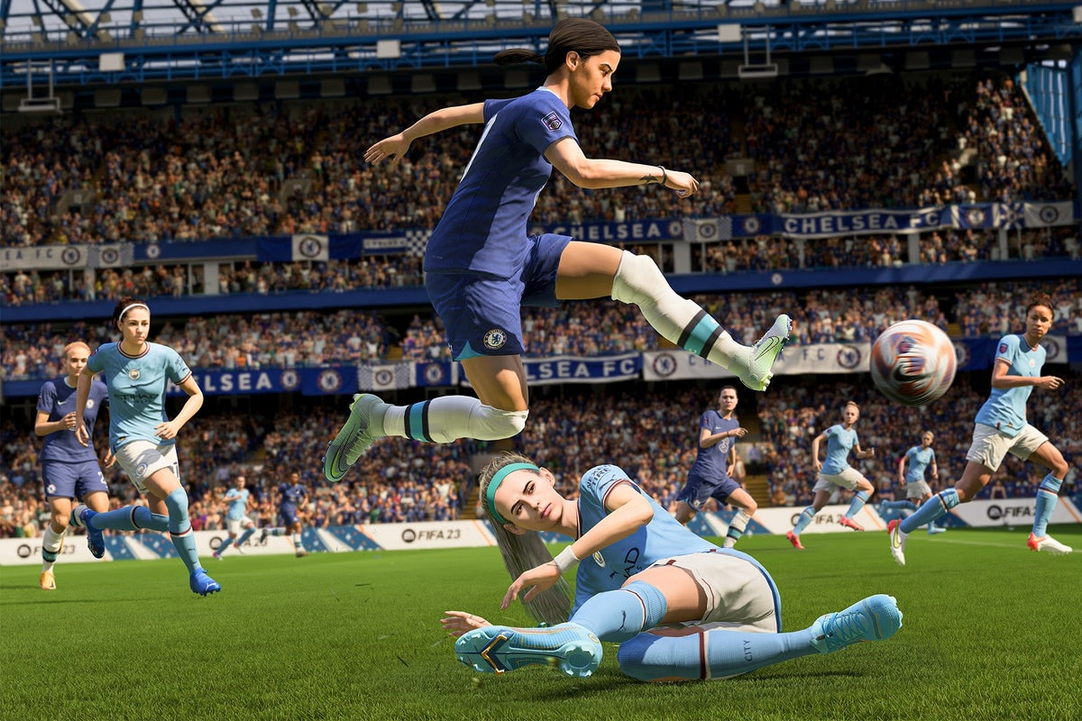
Why not just use online platforms?
Not all pupils have access to devices / WiFi at home.
Having to use a device means distractions from the device.
Devices can be confiscated, which means missed homework and detentions.
Exams are written.

Slide 19
The purposes of homework
Help students know and remember more.
Knowing more and remembering more makes lessons easier, tests easier, and exams easier.
Knowing more and remembering more means students can do more.
Students can achieve higher, reach their potential and access their college courses.
Supports students to become independent and resilient.
Think of what students need to be able to do in year 11

Slide 20
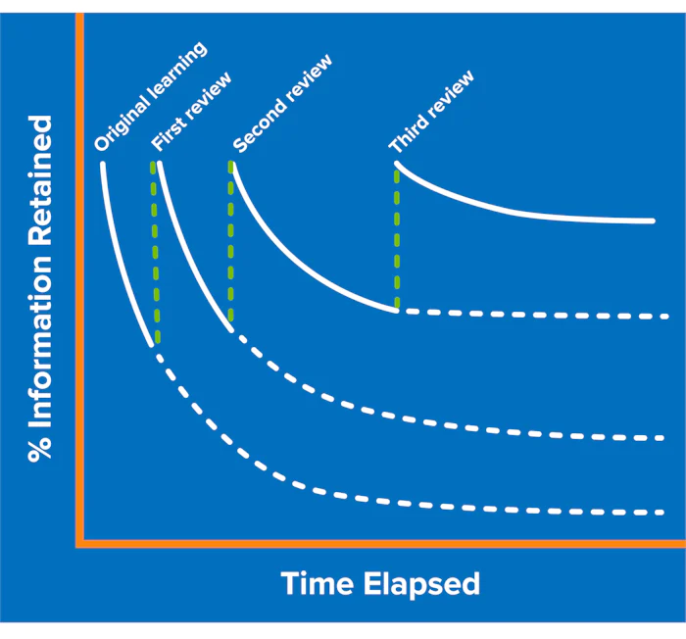
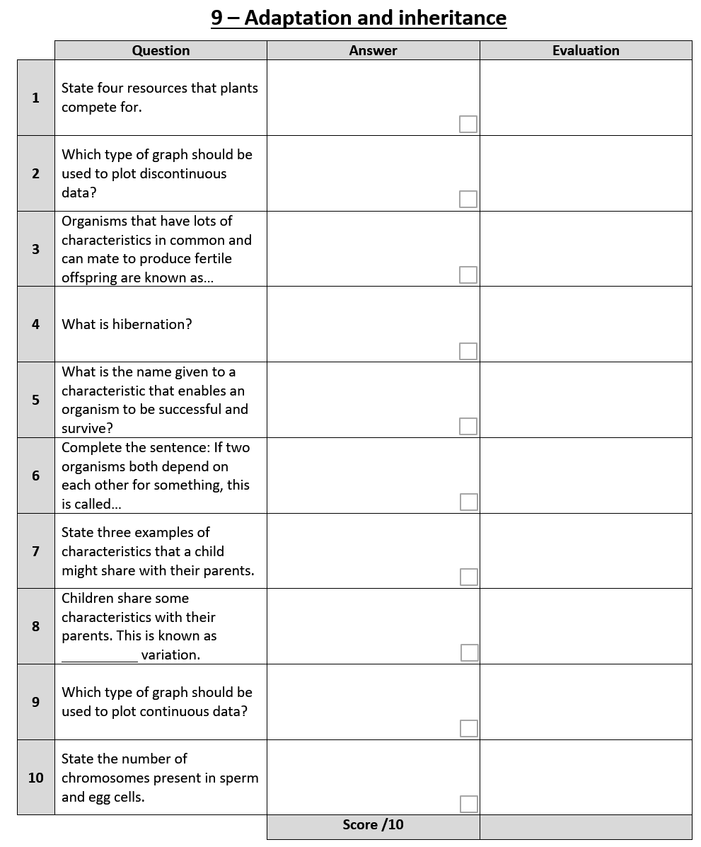
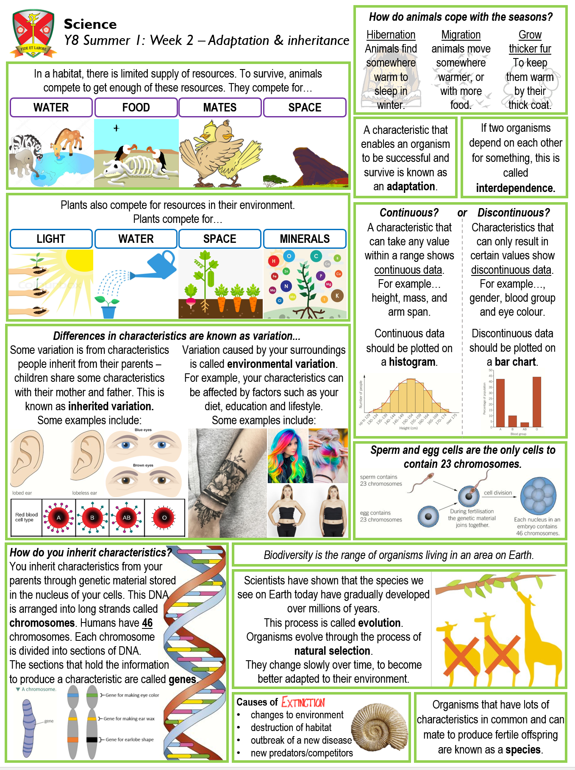
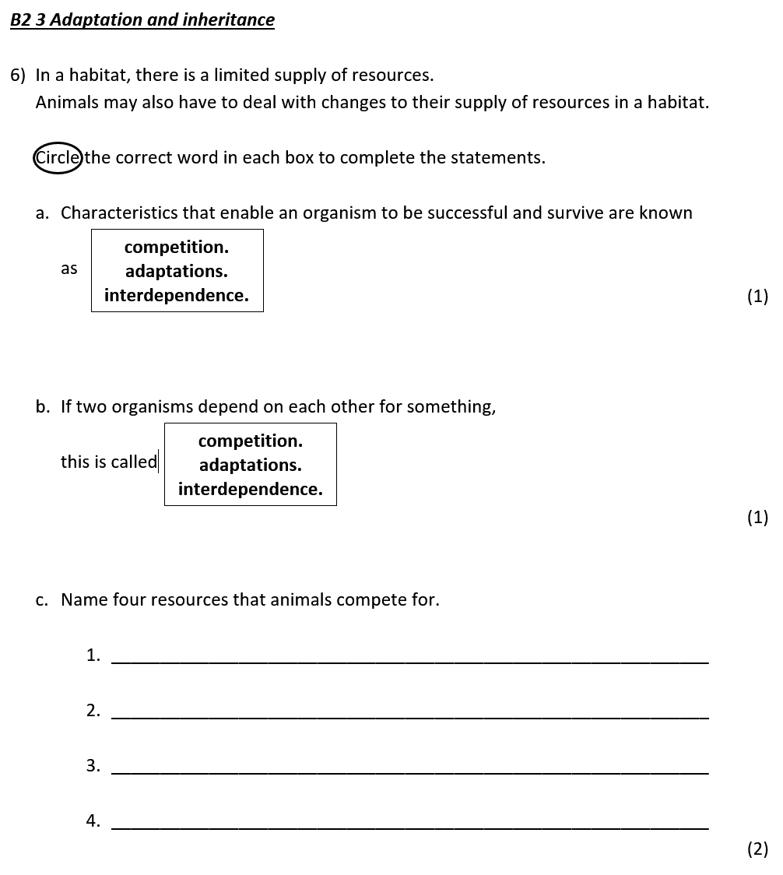
Helping students know and remember more
Essential knowledge
Retention and
retrieval starters
Knowledge
organiser
Essential knowledge
Homework
Essential knowledge
Assessments
Revisiting essential knowledge means students know and remember more.
Essential knowledge
Notes:
SDU

Slide 21
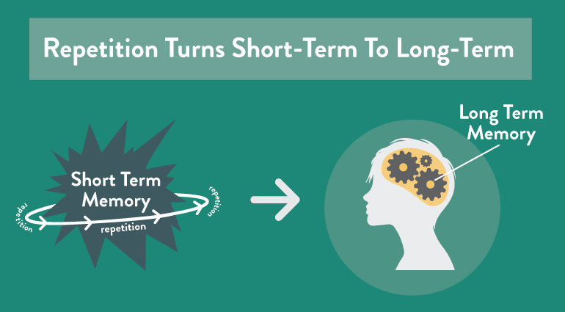
Helping students know and remember more
Essential knowledge
Retention and
retrieval starters
Knowledge
organiser
Essential knowledge
Homework
Storing information in long-term memory frees up working memory.
Essential knowledge
Assessments
Essential knowledge
Find demanding work in lessons easier.
Notes:
SDU

Slide 22
Retention and retrieval Do Nows
Knowledge organiser
Retention and retrieval starter
Notes:
SDU

Slide 23
Homework
Knowledge organiser
Homework
Notes:
DSH

Slide 24
Three Knowledge Organiser assessments per year
Notes:
DSH

Slide 25
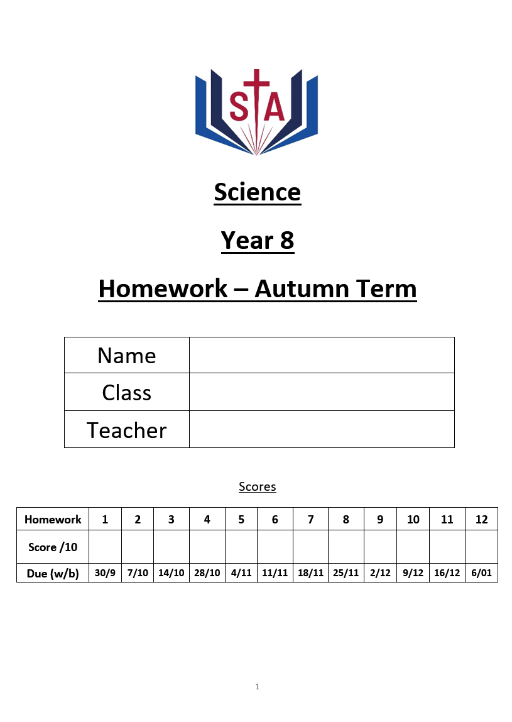
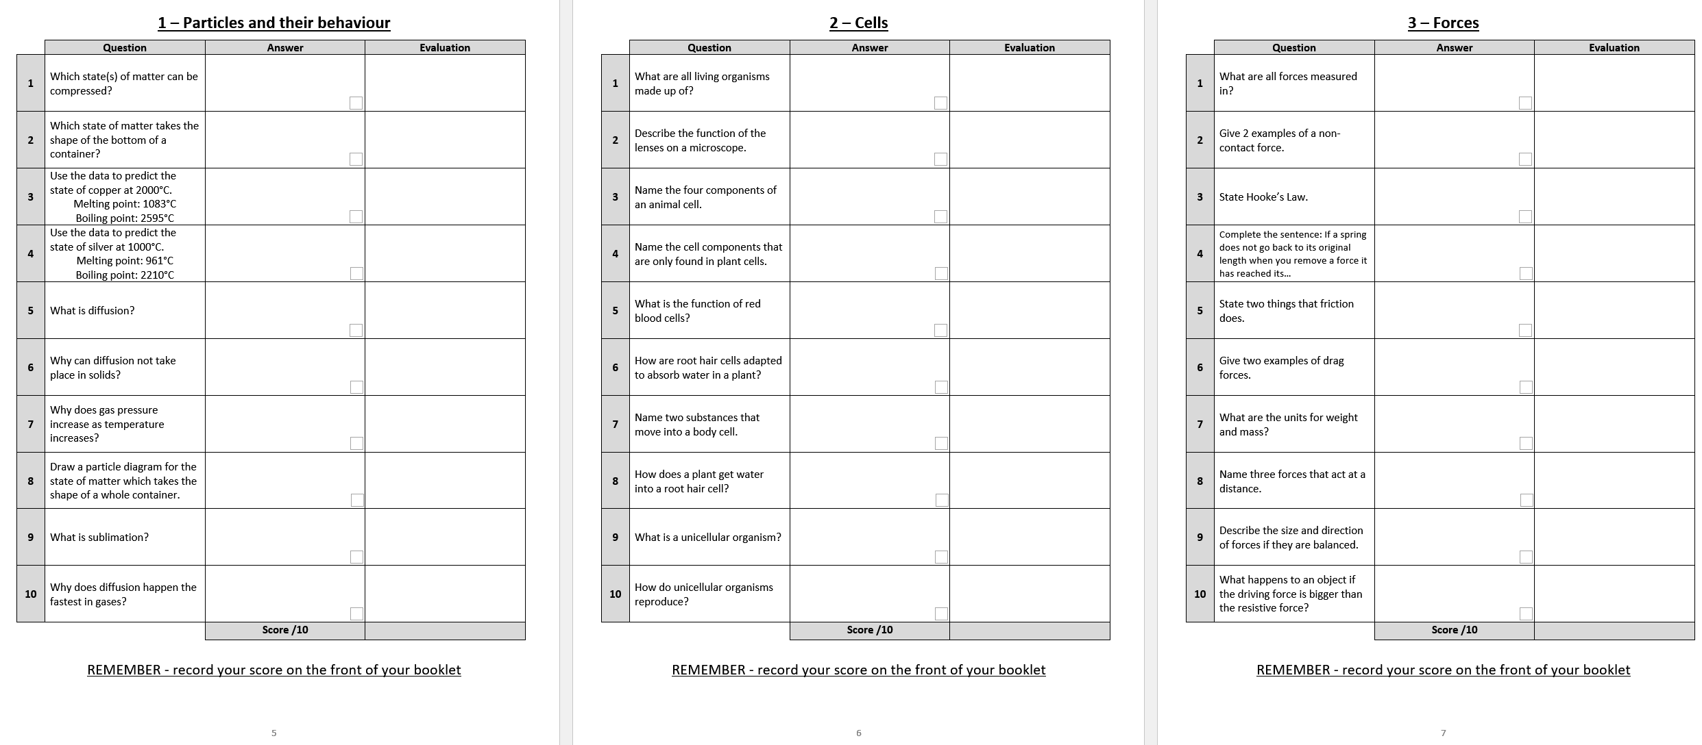
What does homework look like?
Homework booklets with knowledge organisers and
questions.
Notes:
DSH

Slide 26
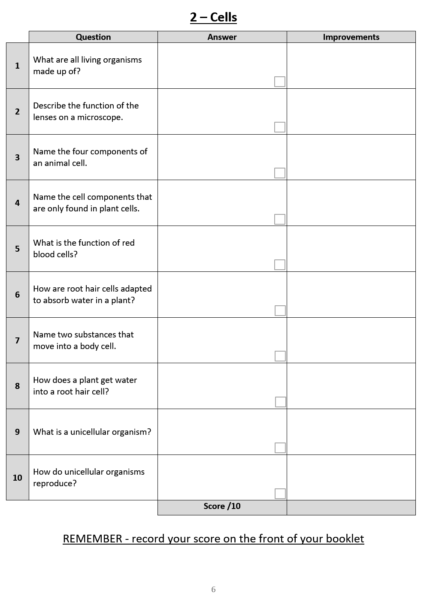
KS3 Homework
Purposes:
Help students know more, remember more and be able to do more.
Embed essential knowledge
Fill in gaps in essential knowledge
Homework booklets (termly or half-termly)
Strategically mapped to revisit prior learning
Knowledge organisers included
10 questions per h/w (weekly or biweekly)
Short answers with space for improvements if needed
Will be linked to assessments
Helps build resilience and independent study skills

Slide 27
Next steps…
Students have been given an A4 plastic wallet to help them look after their booklets
Stay organised and complete homework on time
Teachers have started issuing the new homework booklets
Homework club is available period 6, Mon-Thurs in CR3.
Quiet environment with access to computers.
Make sure their bag is big enough

Slide 28
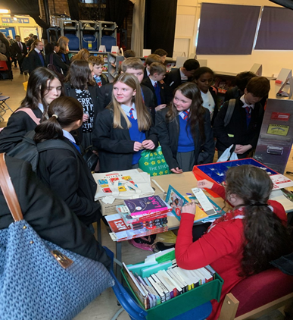
Get Ready to Read!
St Antony's is a reading school and we want all pupils to get involved!
Notes:
Reading! Culture of reading being promoted at school.
This is invaluable for accessing academic texts and tests but also for relaxation.
AND it helps with GCSE outcomes – more on that shortly.

Slide 29
Reading Initiatives 2023/2024
As we develop our new library and reading culture, we want pupils to have a say and to lead the way
More Reading Ambassadors will be recruited in September – a chance for pupils to lead!
We have spent thousands of pounds on new books!
We test and monitor reading ages of all pupils, with more frequent testing for developing readers and those being supported by tutors
We support our developing readers with reading intervention groups 2-3 mornings a week, either in form, or in a small group with a member of staff
Curriculum Leaders are adapting their planning to ensure that reading materials are linked to pupils’ learning and specific subject terminology is highlighted
All teachers are expected to support pupils’ literacy and interest in reading, through recommendations, guidance and support with literacy across all subjects
The English Department have created Key Stage 3 and 4 Reading journeys that complement the learning in curriculum time
Notes:
So critical do we see reading and building literacy competence, that we've been strategic in our actions and planning of reading.
See here the focus on Reading Ambassadors and the library
Also on the monitoring and intervention to support reading – Y10 have now all had their testing completed in an English lesson
Curriculum planning

Slide 30
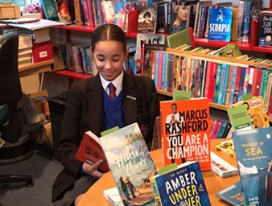
Benefits of Reading
Children who read books often and more than once a week, at 16 gain higher results in maths, vocabulary and spelling tests than those who read less regularly
16-year-olds who choose to read books for pleasure outside of school are more likely to secure managerial or professional jobs later in life

Slide 31
Personal Development
Your child's access to learning is broader than the academic curriculum:
PD lessons – RSHE, SMSC, Citizenship, Careers
Co-curricular offer
Wider-curriculum offer (see pack)
Assemblies
Me and You with Form Tutors
Notes:
PD lessons – cover the legal requirements as set out by the government in law. An overview of the Y10 topics is in your parent pack. Essentially, the lessons are centred on building up each young person's understanding of their self-worth, that their choices, decisions, comments etc reflect that. And on ensuring that young people have access to the information they need to make safe, healthy choices now and in the future, plus signposting to help and support. This is on the website should your child need this at any point.
RSHE – annual consultation launch starts tomorrow with a video explanation on the website. Please look for this and contact us, should you wish to do so
SMSC – threaded through all curriculum areas but most overtly seen in PD lessons – Social, Moral, Spiritual and Cultural development
Citizenship – coverage of the law, how our government works, what decision we have to make as citizens, our British Values
Co-Curric – planned activities for KS4 to fit the lessons they are doing
Extra-curric – open to all – Sports teams, GIFT team, anti-bullying ambassadors, CCF to name a few – more on the website. And we are listening to Parent/Pupil Voice and have an exciting creative arts series of activities planned for each term this year
Assemblies – plotted to map national/international key dates, but also to help young people to reflect, to learn about more than their curriculum content
Me and You – time as a form, but also a chance to re-visit our values – love, respect, service, integrity and resilience. - NEXT SLIDE!!!

Slide 32
How are classes arranged in Year 9?
With the exception of Maths, we have moved to mixed prior attainment arrangements across Y9
In Maths, pupils are divided into two bands. Each band contains Set 1, Set 2 and Set 3

Slide 33
Why have we moved towards more mixed arrangements?
Research does not clearly indicate that one arrangement yields greater rates of progress over the other
Mixed prior attainment enables students to be exposed to a wider range of peers
The majority of subjects at KS4 do not contain exam papers which are tiered (higher and foundation)
Pupils will be inevitably mixed in option subjects at KS4
Primary classes are generally taught in mixed arrangments

Slide 34
Why have we retained Maths setting in Y9?
There remains a case to retain setting in some subjects
Nationally, pupils with lower prior attainment in maths make slower rates of progress compared to those with higher prior attainment
Based on the above, the teacher can focus on the different levels of challenge that each pupil faces and lower sets generally contain fewer pupils
Maths is tiered at KS4 (as are Languages and Science)

Slide 35
Options
Options evening will take place on the 29th February
Parents/Carers evening has been deliberately placed on the 23rd November to help shape your thinking in terms of options
All pupils choose 3 options
All pupils must choose either Geography or History
We shall be pushing the Ebacc qualification (English, Maths, Science, a humanity and a language)
We have heavily invested in our languages department this year

Slide 36
Reports home to You
December Interim Report​ | April Interim Report | July Full report​
Attitude to learning score​ Homework score​ Attendance​ Punctuality​ Reward points​ Behaviour points​ In each subject, a percentage showing how much of the essential knowledge has been retained | Attitude to learning score​ Homework score​ Attendance​ Punctuality​ Reward points​ Behaviour points​ In each subject, a percentage showing how much of the essential knowledge has been retained | Attitude to learning score​ Homework score​ Attendance​ Punctuality​ Reward points​ Behaviour points​ ​In each subject, a percentage showing how much of the essential knowledge has been retained Written comments from teachers​

Slide 37
Failure & Difficulty - Resilience
Notes:
Normal Part of Y10 Experience.
However small, taking a step in the right direction matters – it can only help – starts with turning up every day, then getting to every lesson on time, then engaging with the learning in that lesson, then tackling the homework they’ve been set, then asking for help if they are stuck – lots of small, individual steps, taken day after day after day, that ultimately add up to something bigger and better – that is being prepared for exams that will determine their path in life and what opportunities are possible in life beyond St Antony’s

Slide 38
Key Dates
SEND coffee morning – 10th November 2023
Parent Forum meeting – 17th October 2023
Parent Forum meeting – 6th February 2024
Parent Forum meeting – 11th June 2024
Y9 Parent/Carer Evening – 23rd November 2023
Options evening – 29th February 2024
Y9 data drops and reporting – December, April and July (written report)

Slide 39
Key Staff
Mr Taylor – Head of Year 9
Mr Shaw – SLT link for Y9
Mr Speake – Pastoral Assistant Headteacher
Mr Campbell – Headteacher
Mr Giblin – Deputy Headteacher
Y10 Form Tutors:
9A Mr Reynard
9B Ms Quinn
9C Dr Ingham
9M Ms Stevens
9W Mr Reese

Slide 40
Ofsted Parent View
14 questions
Takes a couple of minutes once logged in

Slide 41
Notes:
and good luck…
We look forward to working with you this year. Please trust us as the experts. We’ve done this lots of times before, there is a skilled team here in school. Support us. It might be your first time as a parent of a KS4 child, but we know how to help. Yes, we will challenge them, yes we will expect lots of them. But we hope that you will too, so that your child can become the best version of themselves.

