Slide 1
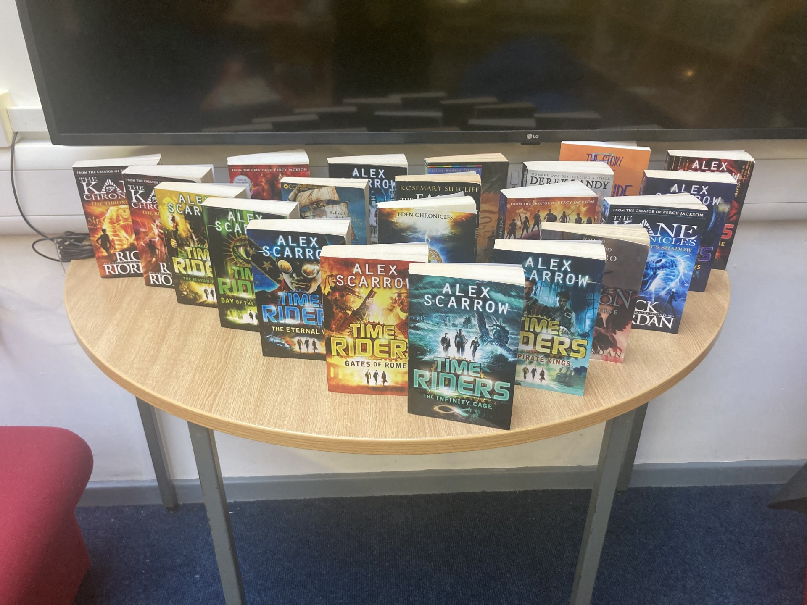
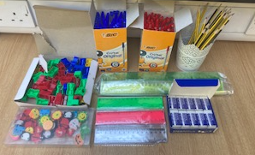
Library
New Books!
Why not join The Sad Ghost Club? Perfect for fans of Heartstopper.
Lose yourself in these magnificent Alex Scarrow time travel novels.
Stationery Shop
From next week there will be a small stationery shop in the library from Monday to Thursday at lunch. We will be selling pens, pencils, rulers, pencil sharpeners etc. So now there's no excuse not to be pen ready in class!
Library opening times: Monday to Friday, every break and lunch
“You can never get a cup of tea large enough or a book long enough to suit me.” C.S. Lewis

