Slide 1

Morning Prayers for Lent

Slide 2
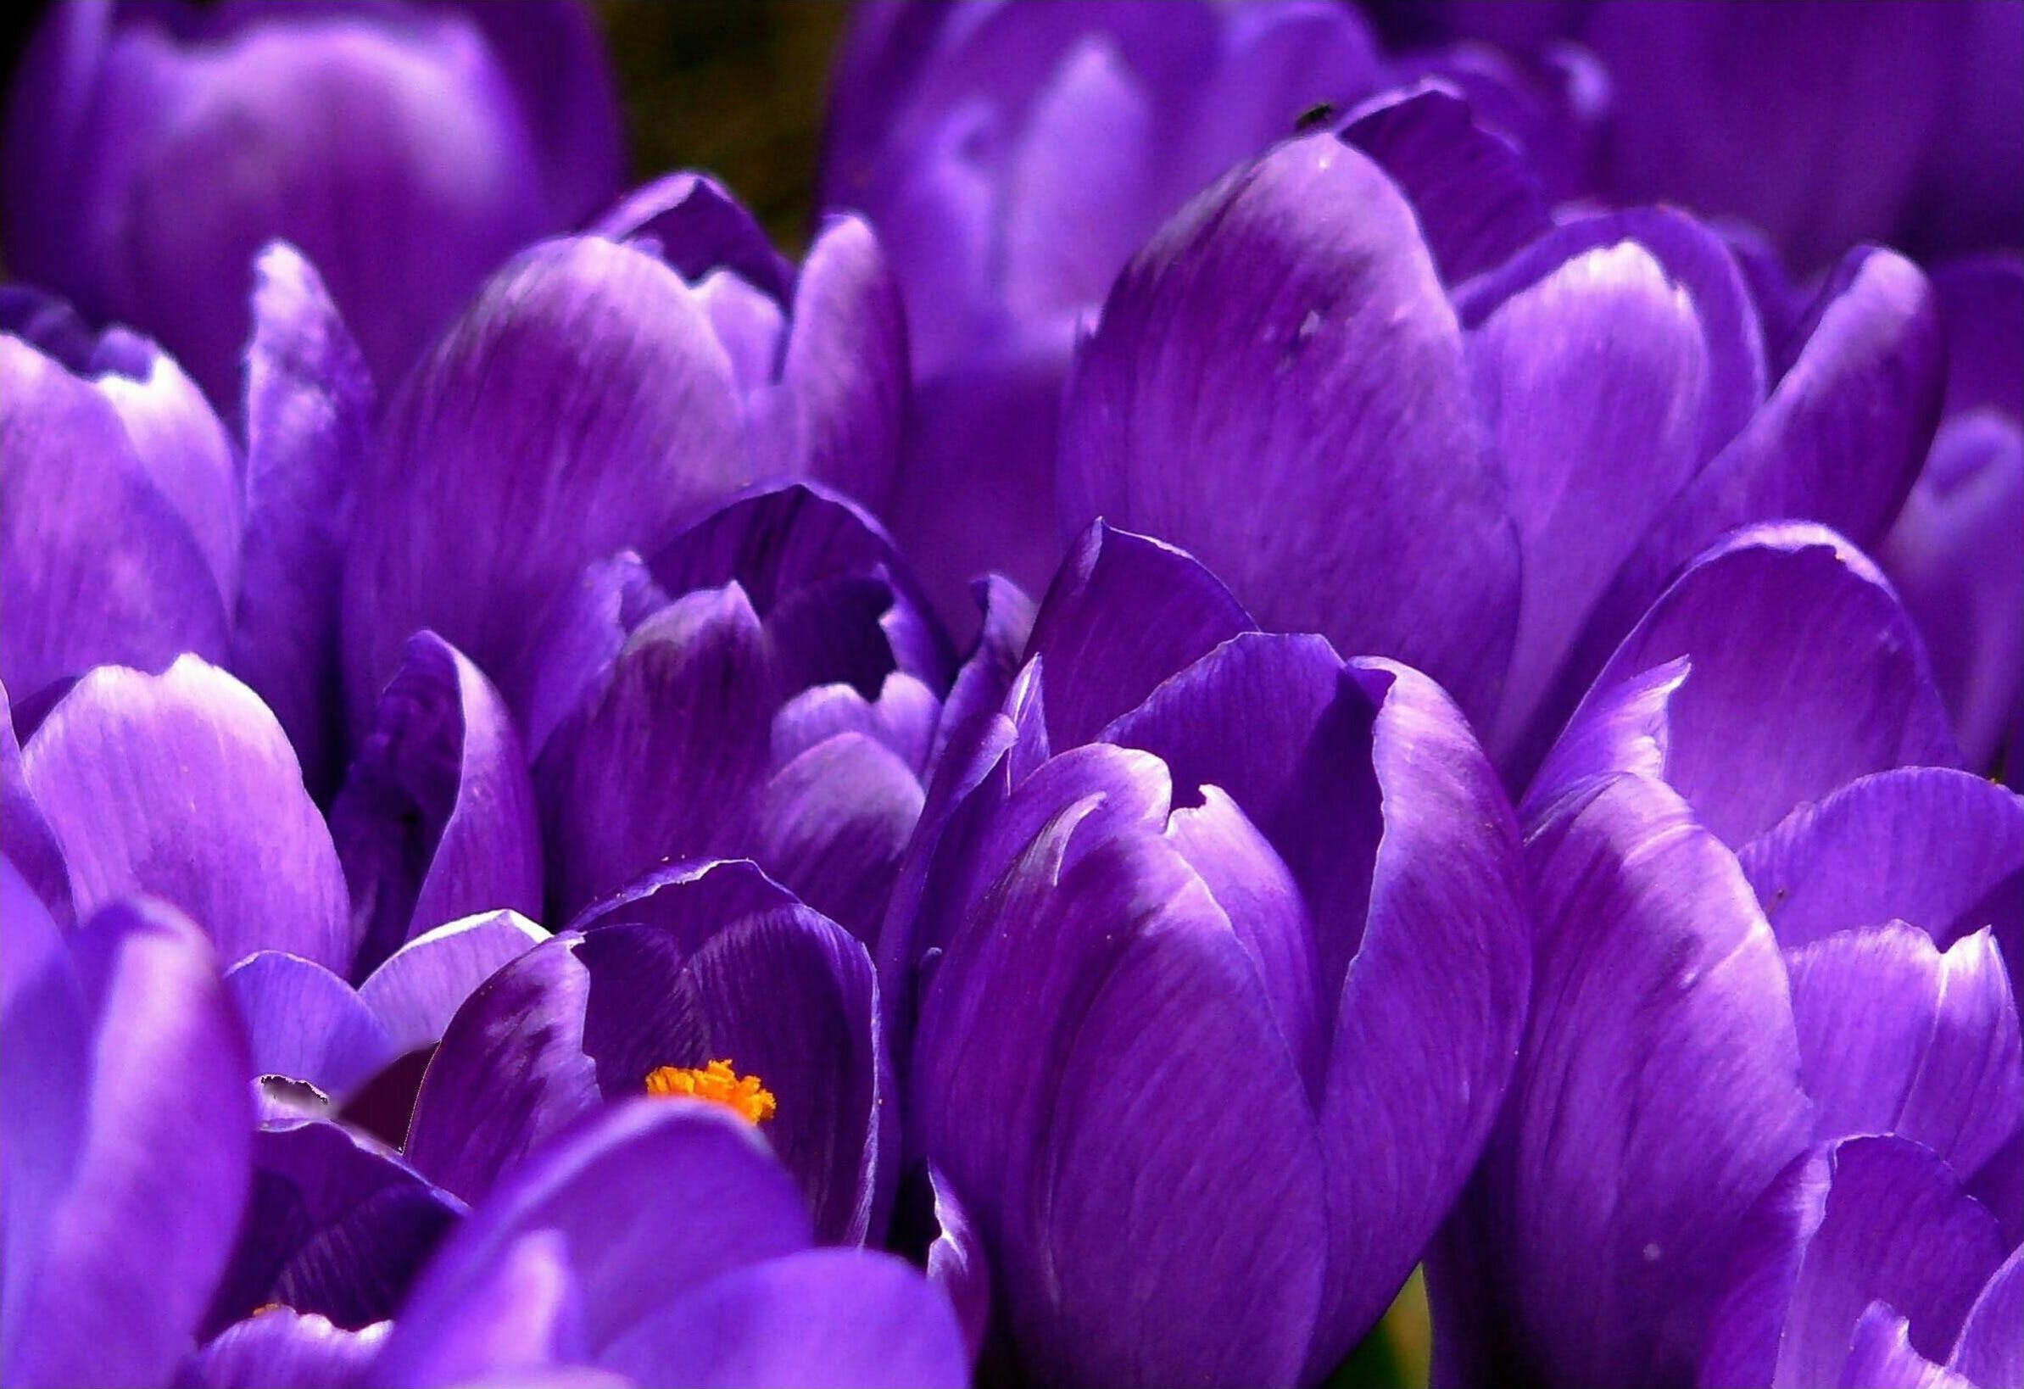
Monday
Today has been good so far,
I’ve been as good as gold, shining like a star.
Let the good day continue for the rest,
and I’ll try my hardest to do my best.
Carry on with no praise
to fast, to give and especially save
I am the best that I can be
Each day from breakfast until tea.
Amen
St Antony of Padua
By Billy G

Slide 3

Tuesday
Ahina’s A prayer on love
Dear Lord,
Fill our hearts with love and support.
Help us to support everyone around us, creating a healthy relationship with all we come into contact with today.
Help us to show our love towards our friends and family and everyone in our St Antony’s community.
Amen
St Antony of Padua

Slide 4
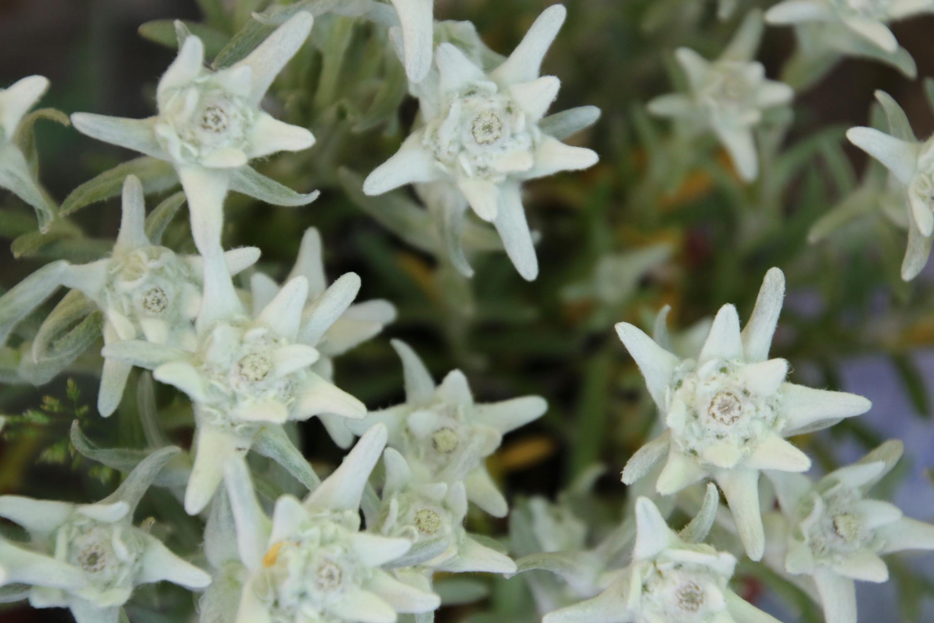
Wednesday
Ryan’s Prayer on forgiveness
Dear God,
Help me love everyone in this world.
Help me donate what I can to those in need
and please forgive me for my mistakes
Help me to make good choices today and always.
Amen
St Antony of Padua

Slide 5

Thursday
Great Lord,
You have shown us the good and bad in the world.
You have been there all along and sacrificed so much to help us.
We ask for your guidance to help those in poverty.
Strength to help those in trouble.
Amen
St Antony of Padua
Notes:
By Xaiver

Slide 6
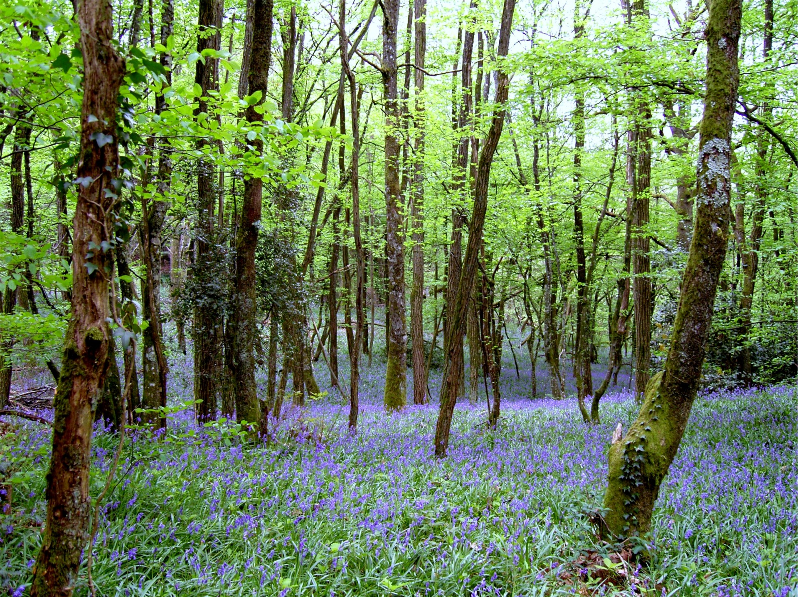
Friday
God,
Please pray for the people in other countries experiencing war and conflict. Please take care of those who are less fortunate than us.
We are thank you for our family, friends and the life you have given us.
Father God bless those who love us and grant us a heart wide open to all.
Amen
St Antony of Padua
Notes:
By Harriet BW

