Slide 1
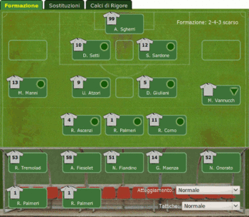
MATCH PROGRAMME
ST ANTONY’S LEGENDS
COME AND WATCH!
COME AND WATCH!
ST ANTONY’S LEGENDS
vs
YEAR 11
Friday 17th May
KICK OFF 16.00
COME AND WATCH!
COME AND WATCH!
YEAR 11

