Slide 1
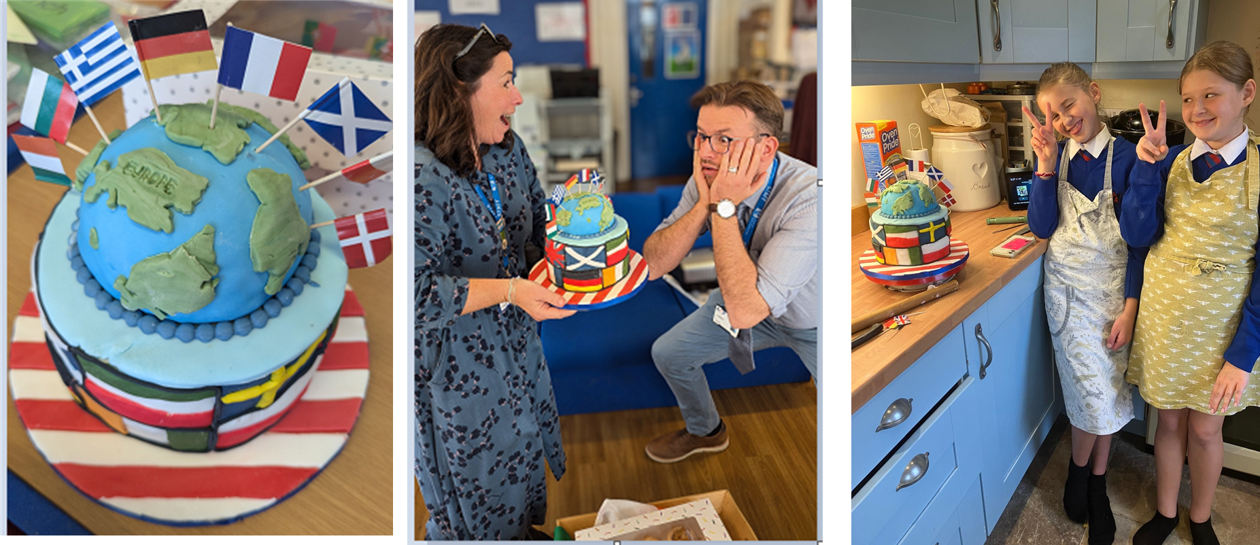
Well done to Maddie and Eliza in 7B
And the winners are…………………….....

