Slide 1
Parent/Carer Information Evening Y10
11th September 2024

Slide 2
Thanks for Coming

Slide 3
The Parent Pack
How to support your child
Tips for your child to achieve well
Key dates for Y10
Coping with exam stress
GCSE Factsheet page
Revision tips and timetable
Academic subject overview
Notes pages
Satchel One guides

Slide 4
Aims
How we can support each other to give your child the best chance of success in Y10, and ultimately in Y11
What’s ahead – what’s involved in this really important, foundation KS4 year?

Slide 5
What do we want for our students?
• Are safe and feel safe
• Happy
• Feel supported
• Included – belong just as much as anyone else
• Pushed to achieve the best in all subjects
• Help students to develop into wonderful human beings
• On the path to become the very best version of themselves

Slide 6
Our Number 1 Priority
LEARNING

Slide 7
How do we tackle our number 1 priority?
Behaviour
Uniform
Attendance
Punctuality
Interaction with adults & peers
Rewards

Slide 8
Rewards

Slide 9
Why is it important for your child to achieve well?
School is about achieving well so that your child can access the courses and careers that they want.

Slide 10
How do I achieve well?

Slide 11
Get what you want by studying hard
There’s nobody in this world that is going to get you what you want.
You’re going to have to go out there and get what you want by studying hard.

Slide 12
How do I achieve well?
Study hard – 100% effort, 100% of the time.

Slide 13
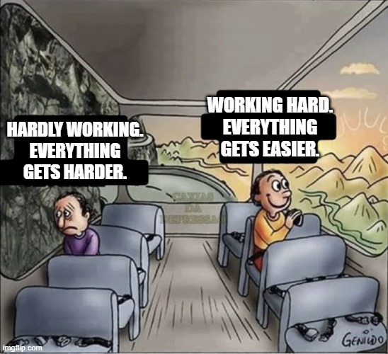
Attitude is everything

Slide 14
Stay positive
We sometimes
have to fail in
order to know how
to succeed.
So do not be afraid
when things go wrong.

Slide 15
2024 Results by Attitude to Learning
The following table shows the link between attitude to learning and the average grade for our 2024 leavers:
Attitude to Learning Groups | Average grade
Students with A to L scores of 4 with some 3s | 5.69
Students mainly with A to L scores of 3 with some 4s | 4.26
Students mainly with A to L scores of 3 or 2 | 3.04
Students mainly with A to L scores of 2 | 1.37

Slide 16
How do I achieve well?
Study hard – 100% effort, 100% of the time.
Positive attitude – Rise to the challenges you are presented with.

Slide 17
Something to think about...
Why do think attendance is so important?

Slide 18
The learning jigsaw
Each lesson is like a piece in a jigsaw.

Slide 19
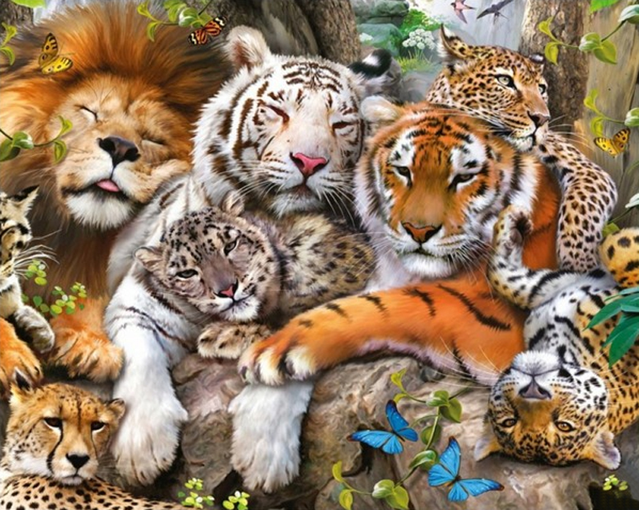

Slide 20
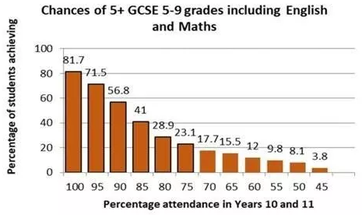

Slide 21
2024 Results by Attendance
The following table shows the link between attendance and the average grade for our 2024 leavers:
Group | Attendance | Average grade
1 | Students with 96.5% attendance or higher (1-week absence or less) | 4.78
2 | Students with 93% - 96.5% attendance (between 1 and 2-weeks absence) | 4.12
3 | Students with 90% - 93% attendance (between 2 and 3-weeks absence) | 3.94
4 | Students with 80% - 90% attendance (between 5 and 3-weeks absence) | 3.46
5 | Students with attendance below 80% | 1.89

Slide 22
How do I achieve well?
Study hard – 100% effort, 100% of the time.
Positive attitude – Rise to the challenges you are presented with.
Attend everything – Lessons, form. All part of the jigsaw.

Slide 23
2024 Results by Homework
The following table shows the link between homework and the average grade for our 2024 leavers:
Homework Groups | Average grade
Students mainly with homework scores of 4 and 3 | 5.90
Students mainly with homework scores of 3 with some 4s | 4.25
Students mainly with homework scores of 3s and 2s | 3.04
Students mainly with homework scores of 2 | 1.62

Slide 24
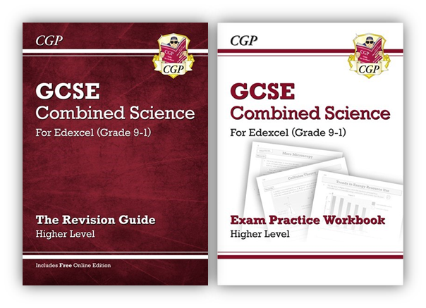
How do I achieve well?
Study hard – 100% effort, 100% of the time.
Positive attitude – Rise to the challenges you are presented with.
Attend everything – Lessons, form. All part of the jigsaw.
Homework (revision) – Complete it properly and on time.

Slide 25
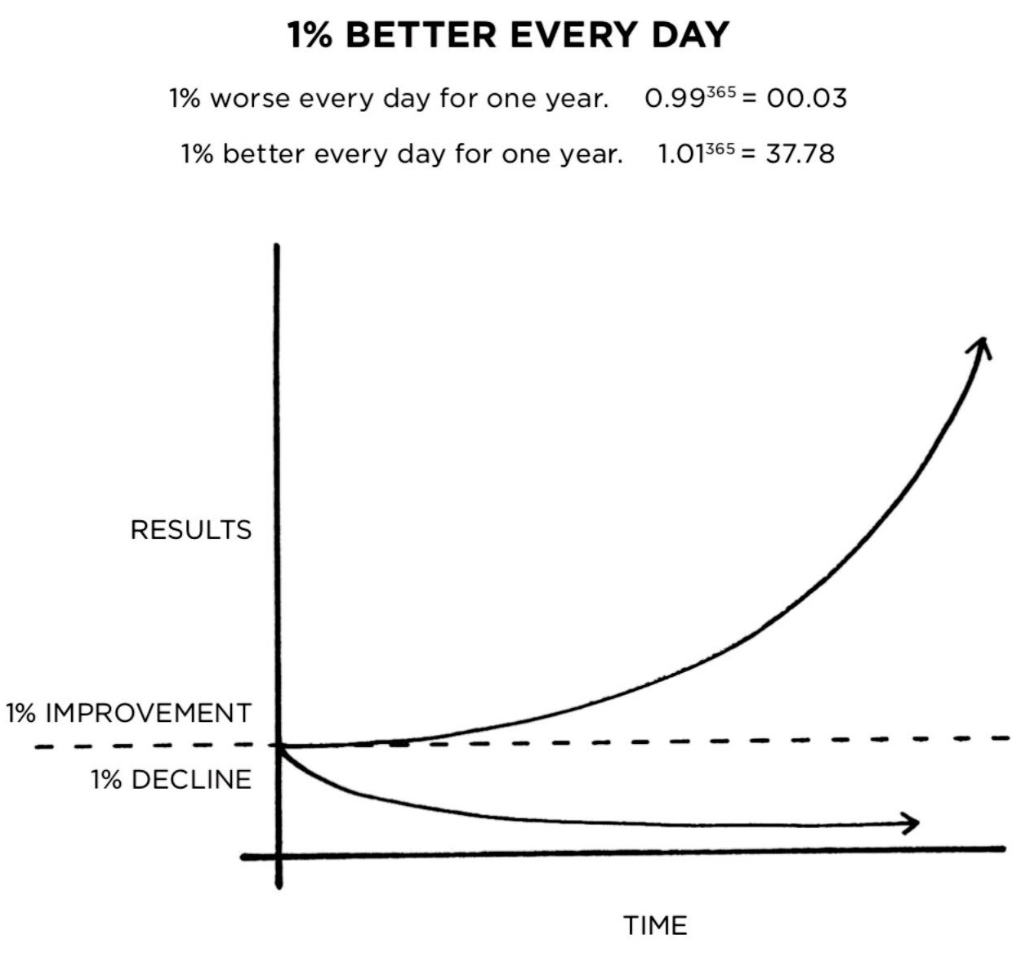
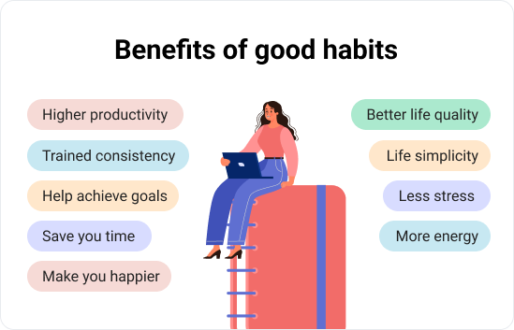
Build good habits
Eat breakfast.
Arrive on time.
Concentrate on learning.
Avoid distractions.
Listen carefully to your teachers.
Complete all work with 100% effort.
Complete your homework as soon as you get home, BEFORE relaxing.
Study at home with your phone switched off.
Get a good night’s sleep.

Slide 26
2024 Results by Reading
The following table shows the link between reading and the average grade for our 2024 leavers:
Reading age | Average grade
17 years | 5.23
16 years | 4.87
15 years | 4.16
14 years | 3.90
13 years | 3.96
12 years | 3.74
11 years | 3.03
10 years and below | 2.73

Slide 27
How do I achieve well?
Study hard – 100% effort, 100% of the time.
Positive attitude – Rise to the challenges you are presented with.
Attend everything – Lessons, form. All part of the jigsaw.
Homework (revision) – Complete it properly and on time.
Build good habits – Small positive choices become automatic.

Slide 28
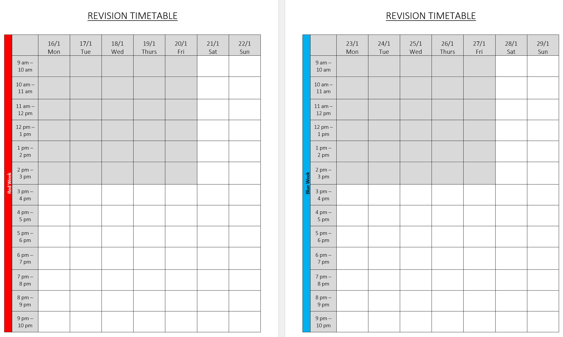
How do I achieve well?
Study hard – 100% effort, 100% of the time.
Positive attitude – Rise to the challenges you are presented with.
Attend everything – Lessons, form. All part of the jigsaw.
Homework (revision) – Complete it properly and on time.
Build good habits – Small positive choices become automatic.
Be organised – Make a plan and stick to it.

Slide 29
How do I achieve well?
Study hard – 100% effort, 100% of the time.
Positive attitude – Rise to the challenges you are presented with.
Attend everything – Lessons, form. All part of the jigsaw.
Homework (revision) – Complete it properly and on time.
Build good habits – Small positive choices become automatic.
Be organised – Make a plan and stick to it.
Seize opportunities – E.g. Homework club.

Slide 30
Resilience - When times get hard, work harder
Notes:
..

Slide 31
How do I achieve well?
Study hard – 100% effort, 100% of the time.
Positive attitude – Rise to the challenges you are presented with.
Attend everything – Lessons, form. All part of the jigsaw.
Homework (revision) – Complete it properly and on time.
Build good habits – Small positive choices become automatic.
Be organised – Make a plan and stick to it.
Seize opportunities – E.g. Homework club.
Resilience - When times get hard, work harder. Then work harder. Then work even harder. No excuses.

Slide 32
The GCSE Exams in Summer 2026
Students will sit in excess of 20 different exams during a 4-week period either side of the May Half Term break in 2026
Unlike 2022, there will be no content adjustment or adaptations

Slide 33
The GCSE Exams in Summer 2026
Most will gain 9 GCSE / Voc qualifications
4 exams in English Language & English Lit
3 exams in Maths
6 exams in Science
3 exams in RE
3 exams in History or 3 in Geography
Plus more exams in their other option subjects (how many depends on what they have selected)
For all students they will be sitting over 20 different exams in a 5-week period in May / June of 2026

Slide 34
Your role in supporting their GCSE Outcomes
The GCSE results from the summer reinforced a key fact – that the more pupils attend school, the better their outcomes
Please do everything you can to ensure your child attends school every day
If pupils are not in, we cannot help them
Please avoid appointments, meetings etc during the school day

Slide 35
Your Support makes a HUGE difference…
Parental support is more important in determining a child’s academic success than other factors outside of secondary school
More than KS2 outcomes
More than social class
Only by working together can we maximise the life chances of our children
We thank you in advance for your support over the next two years

Slide 36
Your role in supporting your child’s GCSE outcomes
Make sure your child attends school every day.
Make sure your child arrives to school on time.
Ensure any routine medical appointments are made outside of school hours.
Check their homework daily to help them with organisation.
Remember that holidays are only a break from attending school and pupils should not see it as a break from work. They should be completing some form of work or revision EVERY DAY.
Ensure your child has access to a quiet space that is conducive for work and revision.
If you have any concerns at all about your child, then your first point of contact should be with their Form Tutor.
Encourage your child to take advantage of all of the extra facilities offered in support of their studies.
Encourage your child to complete their homework as soon as they get home.
Help your child avoid “time eaters”.

Slide 37
Help your child avoid “time eaters”
What is eating your child’s time?
How much of your child’s time is eaten each day?
How much time each week?
How much easier would your child find school if this time was spent studying?
Completing homework as soon as your child arrives home, BEFORE falling down a rabbit hole that time eaters provide, will help your child be successful this year.

Slide 38
Attendance
If a pupil has an overall attendance of 95%, this may sound good, yet it actually means the pupil will have missed 9.5 days of lessons, which is nearly 50 hours of input from their class teachers that they will never get back – plus lost opportunities for intervention and support.

Slide 39
Punctuality
Pupils should be in school, ready for the day by 8:45am.
Once the second bell has gone at 8:50am… they are LATE!
Registration and form time is:
The legal school register for the morning
When a Form Tutor can check in with a student
When a form tutor can have some pastoral time with the whole form
When important messages about the school day are shared
When HoYs can find students to check in with them
When Pastoral support can be provided
When form reading happens to improve literacy

Slide 40
How else can you support your child?
Patience, Love, Care
Support, Guidance, Organisation
Independent Study

Slide 41
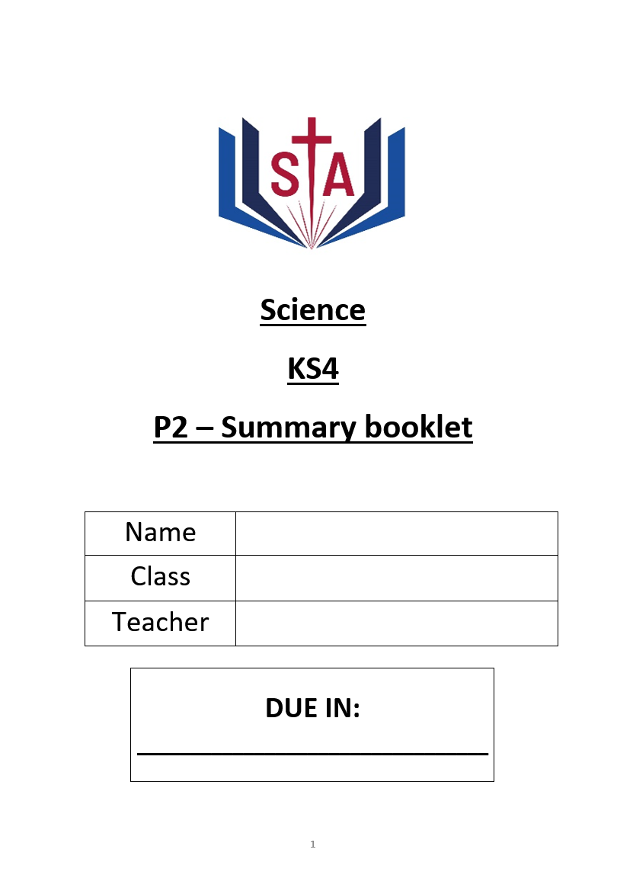
Year 10 homework / revision
Purpose: Help students know more, remember more and be able to do more.
This makes lessons easier, tests easier, and exams easier.
Helps students achieve higher, reach their potential and access their college courses.
Supports them to become independent and resilient.

Slide 42
Year 10 homework / revision
Purpose: Help students know more, remember more and be able to do more.
Revision guides and knowledge organisers provide the knowledge.
Homework booklets provide the questions and space to write answers.

Slide 43
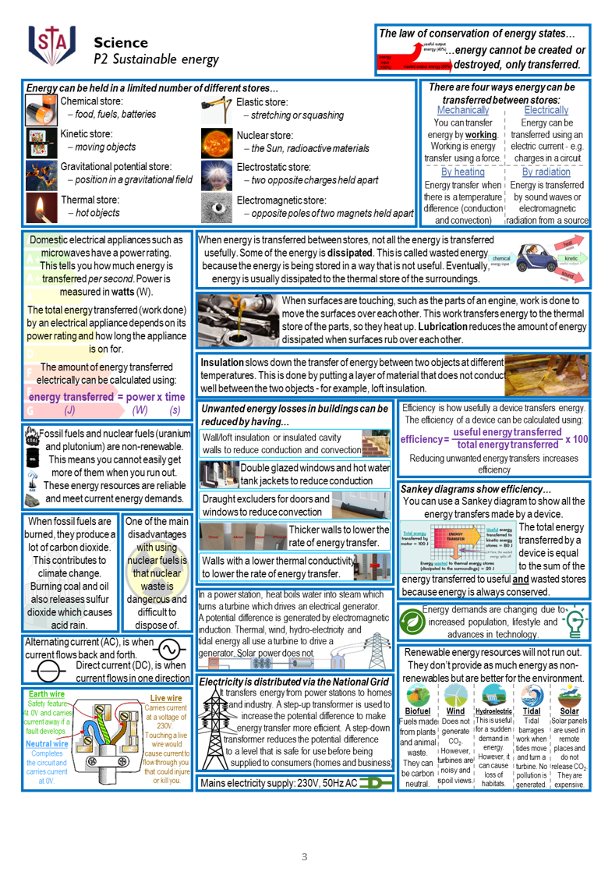
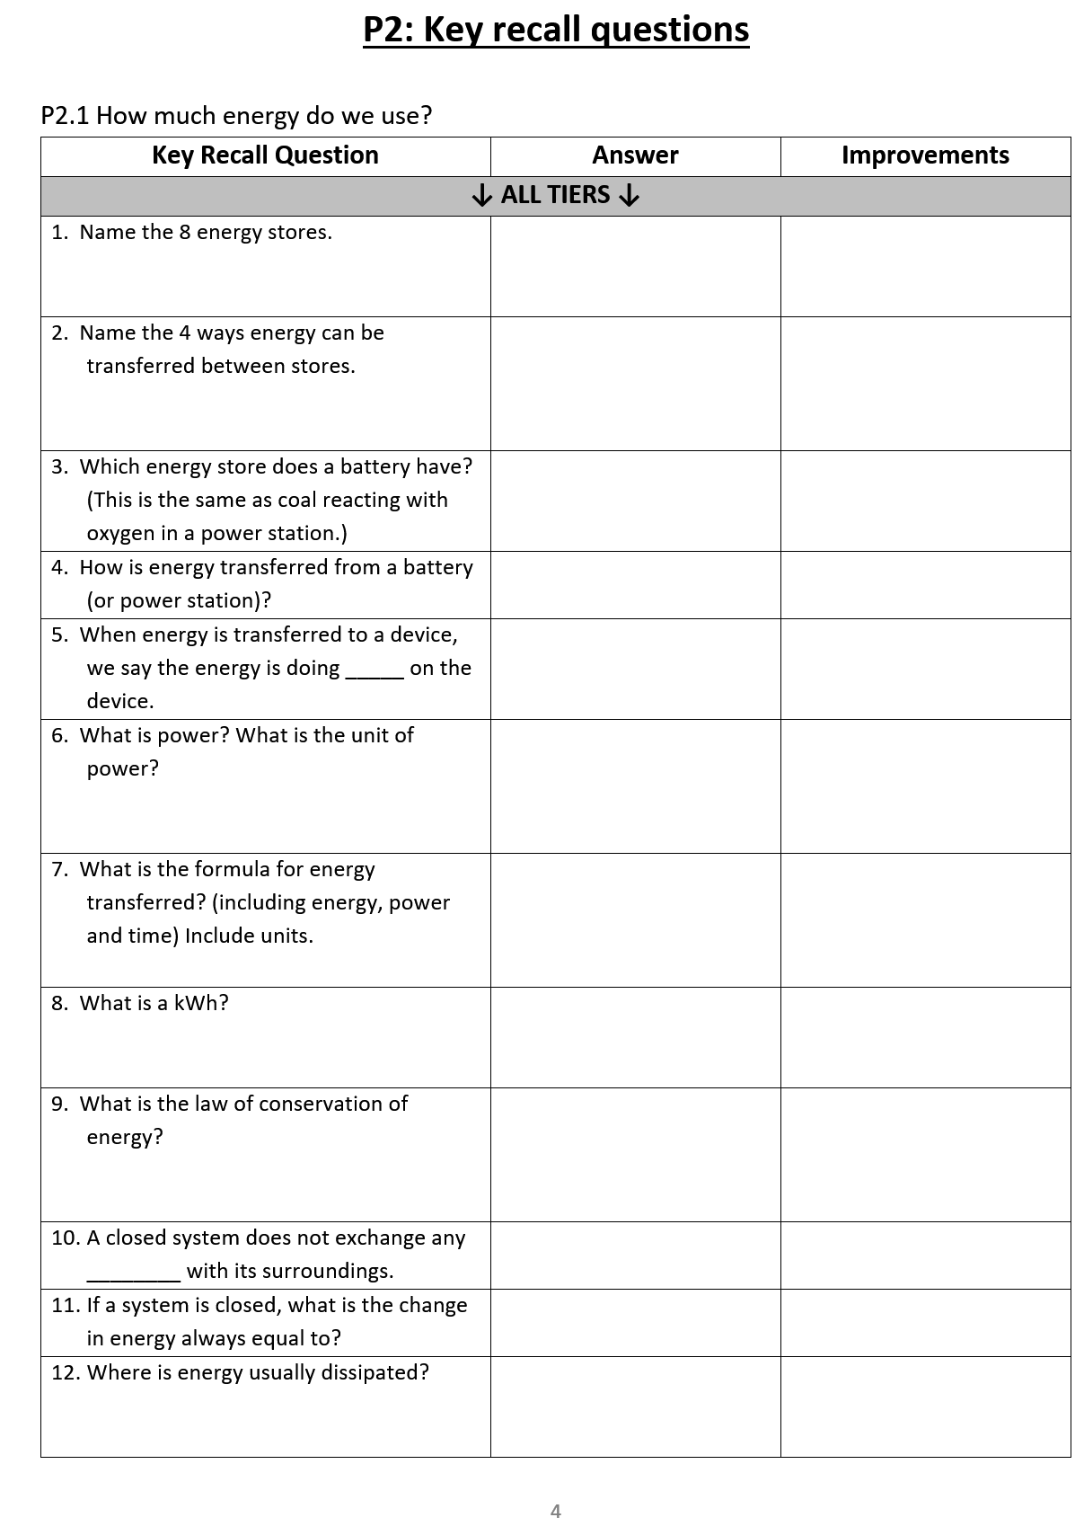
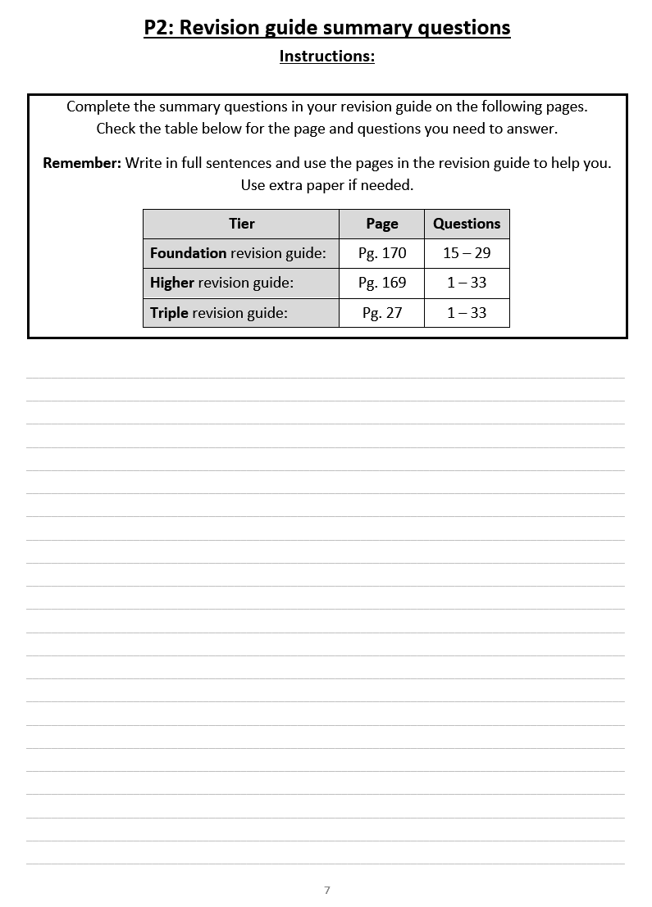
Year 10 homework / revision
Tried, tested and PROVEN TO WORK
Students will use revision guides in Year 11 too

Slide 44
2024 Results by Homework
The following table shows the link between homework and the average grade for our 2024 leavers:
Homework Groups | Average grade
Students mainly with homework scores of 4 and 3 | 5.90
Students mainly with homework scores of 3 with some 4s | 4.25
Students mainly with homework scores of 3s and 2s | 3.04
Students mainly with homework scores of 2 | 1.62

Slide 45
Year 10 homework / revision
Students have been given an A4 plastic folder to look after their homework booklets
Homework club is available period 6, Mon-Thurs in CR5.
Quiet environment with access to computers.
Stay organised and complete homework on time
Please ensure they have a big enough bag

Slide 46
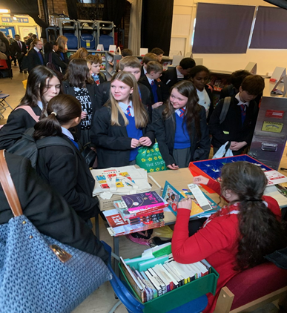
Get Ready to Read!
St Antony's is a reading school and we want all pupils to get involved!

Slide 47
Reading Initiatives 2024/2025
As we develop our new library and reading culture, we want pupils to have a say and to lead the way
More Reading Ambassadors will be recruited in September – a chance for pupils to lead!
We have spent thousands of pounds on new books!
We test and monitor reading ages of all pupils, with more frequent testing for developing readers and those being supported by tutors
We support our developing readers with reading intervention groups 2-3 mornings a week, either in form, or in a small group with a member of staff
Curriculum Leaders are adapting their planning to ensure that reading materials are linked to pupils’ learning and specific subject terminology is highlighted
All teachers are expected to support pupils’ literacy and interest in reading, through recommendations, guidance and support with literacy across all subjects
The English Department have created Key Stage 3 and 4 Reading journeys that complement the learning in curriculum time

Slide 48
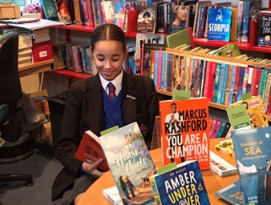
Benefits of Reading
Children who read books often and more than once a week, at 16 gain higher results in maths, vocabulary and spelling tests than those who read less regularly
16-year-olds who choose to read books for pleasure outside of school are more likely to secure managerial or professional jobs later in life

Slide 49
2024 Results by Reading
The following table shows the link between reading and the average grade for our 2024 leavers:
Reading age | Average grade
17 years | 5.23
16 years | 4.87
15 years | 4.16
14 years | 3.90
13 years | 3.96
12 years | 3.74
11 years | 3.03
10 years and below | 2.73

Slide 50
The Year 10 Curriculum
Subject | Autumn 1 | Autumn 2 | Spring 1 | Spring 2 | Summer 1 | Summer 2
Art, Craft and Design Subjects | Project 1: My Surroundings During this term, pupils will undertake research to form the basis of a personalised project on ‘My Surroundings’. They will use artist references and mixed media as a basis for the required portfolio of work. |  | Project 1: My Surroundings Pupils will continue to develop mixed media imagery in response to research and create a final sustained outcome for the portfolio. |  | Major Project Pupils will begin work on the major project. This will take them through to Christmas of Y11. The project will include research, artist references and mixed media.
Business | Business Activity -The nature of business activity producing goods and services - Business enterprise - Business planning - Aims and objectives | Business Activity -Business ownership - Business growth - Location of business | Influence on Business -Technology in business - Ethical issues - Environmental issues - Economic influences | Influence on Business -Economic influences (cont) - Globalisation - Laws & impact on business | Business Operations -Methods of production (job, batch, flow) - Quality in production - Sales process - Supply chain | Business Operations -Recruitment - Types of training - Methods of motivation - Types of organisational structures
Computer Science | -System Architecture -Memory & Storage -Python Programming: ongoing skills | -Memory & Storage -Python Programming: ongoing skills | -Computer networks connections and protocols -Python Programming: ongoing skills | -Python Programming: ongoing skills | -Systems software -Python Programming: ongoing skills | -Ethical legal cultural -Python Programming: ongoing skills
English | -Explorations in creative reading and writing | -‘An Inspector Calls’ by JB Priestley (faster reading) & deeper study | -‘Macbeth’ by William Shakespeare -Creative writing | -‘The Strange Case of Dr Jekyll and Mr Hyde’ & using the text for Lang Paper 1 | -Poetry: ‘Power and Conflict’ -Spoken Language Assessment -Flashback Fridays on ‘An Inspector Calls’
French | Theme 1: Identity and Culture Topic 1: Me, my family and friends -Relationships with family and friends -Marriage/partnerships | Theme 1: Identity and Culture Topic 3: Free-time activities -Music -Cinema and TV Food and eating out -Sport | Theme 1: Identity and Culture Topic 2: Technology and everyday life -Social media -Mobile technology | Theme 1: Identity and Culture Topic 4 -Customs and festivals in French-speaking countries | Theme 2: Local, national, and international areas of interest Topic 1 -Home, town, neighbourhood and region | Theme 2: Local, national and international areas of interest Topic 2: Social issues -Charity/voluntary work -Healthy/unhealthy living
Geography | -Coasts and ecosystems | -Ecosystems under threat Desertification | -Global cities | -Urban and rural environments | -Rivers | -Rivers -Human fieldwork
History | Medicine through time -This unit incorporates medicine from the ancient world through to the NHS -The unit includes a case study of medicine in World War |  | Weimar and Nazi Germany -The impact of World War I -The rise of Hitler |  | Elizabeth I | Elizabeth I

Slide 51
The Year 10 Curriculum - continued
Subject | Autumn 1 | Autumn 2 | Spring 1 | Spring 2 | Summer 1 | Summer 2
Maths | -Congruence, similarity and enlargement -Trigonometry | -Representing solutions of equations and inequalities -Simultaneous equations -Angles and bearings | -Working with circles -Vectors -Ratios and fractions | -Percentages and interest -Probability | -Collecting, representing and interpreting data -Non-calculator methods | -Types no number and sequences -Indices and roots -Manipulating expressions
PE Sports Science | Nutrition and Sports Performance. Nutrients for a healthy plan | Nutrition and Sports Performance. Nutrients for a healthy plan | Applying the principles of training. Fitness and how it affects skill performance. | Applying the principles of training. Principles of training in sport. | Applying the principles of training. Organising and planning a fitness programme. | Applying the principles of training. Evaluate own performance.
PE GCSE | Skeletal System. Muscular system. | Movement analysis. Cardiovascular and Respiratory system. | Effects of exercise. Components of fitness. | Principles of training. Prevention of injury. | Coursework completion. | Coursework completion.
RE | Origins and Meanings -Origins of the universe -Creation in Genesis -The value of human life | Origins and Meanings -The environment -Catholic Social Teaching -Interfaith dialogue -The work of CAFOD and SVP | Good and Evil continued -The Trinity -The Incarnation -The origin of evil -Goodness | Good and Evil continued -Responses to evil -Jesus as a moral authority -Sculptures and statues -Pilgrimage -The Rosary | Life and Death -Catholic beliefs about dying well -The Resurrection -Life after death -Euthanasia -The Magisterium | Life and Death continued -The Second Vatican council -Christian sarcophagi -The Paschal Candle -Music in the liturgy -Funerals -Prayer
Science (Triple cover topics in greater depth) | -Space physics -Astronomy (Triple) -Genetics -Chemical bonding | -Waves and the EM spectrum -Evolution | -Acids and alkalis -Forces and their effects | -Plants -Radioactivity | -The Earth’s atmosphere -The particle model | -The endocrine system

Slide 52
Reports Home to You
The following table indicates the general content of this year's reports:
December Report​ | April Written Report | July report​
Attitude to learning score​ Homework score​ Attendance​ Punctuality​ Reward points​ Behaviour points​ | Attitude to learning score​ Homework score​ Attendance​ Punctuality​ Reward points​ Behaviour points​ Current working grade in each subject​ Written comments from teachers​ | Attitude to learning score​ Homework score​ Attendance​ Punctuality​ Reward points​ Behaviour points​ Current working grade in each subject​

Slide 53
Personal Development
Your child's access to learning is broader than the academic curriculum:
PD lessons – RSHE, SMSC, Citizenship, Careers
Co-curricular offer
Wider-curriculum offer
Assemblies
Me and You with Form Tutors

Slide 54
Failure & Difficulty - Resilience

Slide 55
Key Dates
Y10 Parent/Carer Evening – 16th January 2024
Y10 data drops and reporting – December, April and July
Y10 end of year exams – May/June 2024

Slide 56
Key Staff
Mr Stapley – Head of Year 10
Mr Speake – SLT link for Y10
Mr Campbell – Headteacher
Mr Giblin – Deputy Headteacher
Y10 Form Tutors:
10A Mr Taylor
10B Ms Quinn
10C Dr Ingham
10M Ms Stevens

