Slide 1
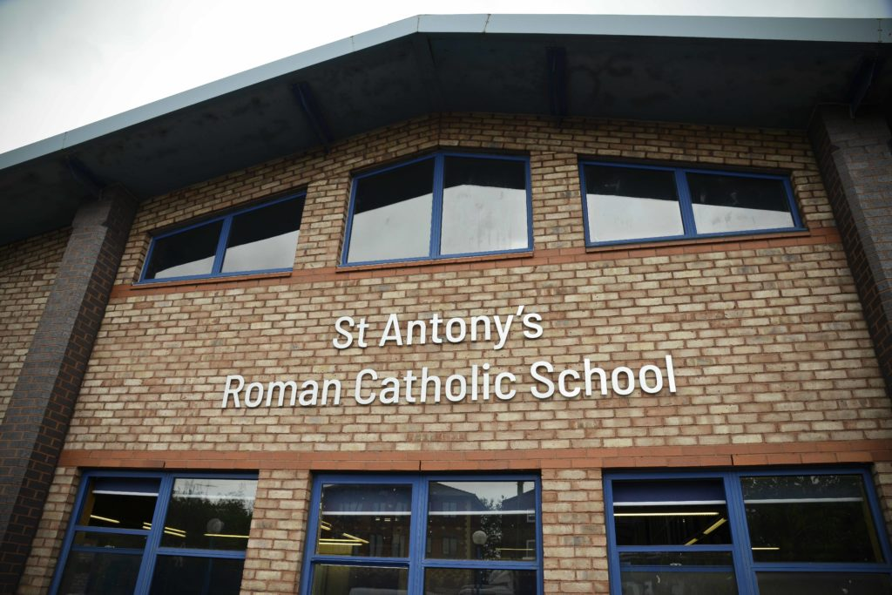

Welcome to the Year 11 Parental Information Evening
Tuesday 10th September 2024

Slide 2

Thanks for Coming

Slide 3

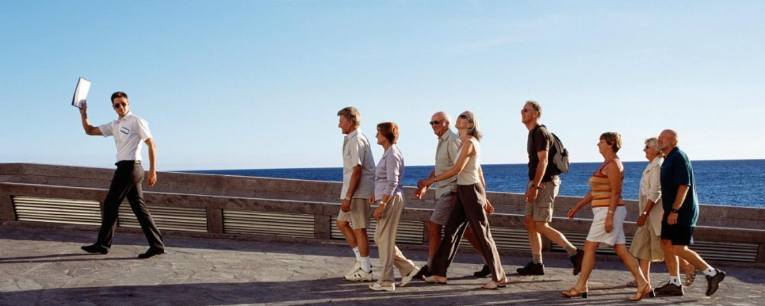
Aims of the evening
Helping you feel a bit less like this…
…and a bit more like this.

Slide 4
Aims of the evening
What happens in year 11.
What your child needs to do to achieve well.
How you can support your child to achieve well.

Slide 5


Your Support Makes a HUGE Difference…

Slide 6

Key Members of Staff
Mr Campbell – Head teacher
Mr Giblin – Deputy Head
Mrs Hayes – Head of Year 11
Mr Shaw, Mrs Doherty and Mrs Adderley – Assistant Heads and Y11 Senior Links
Mr Speake – Assistant Head (pastoral)
Mr James – Assistant Head (pastoral)
Y11 Form Tutors:
11A Mr Manford
11B Mrs Nuttall
11C Mr White
11M Mr Kearney
11W Mr Brownbill

Slide 7
Aims of the evening
What happens in year 11.
What your child needs to do to achieve well.
How you can support your child to achieve well.

Slide 8
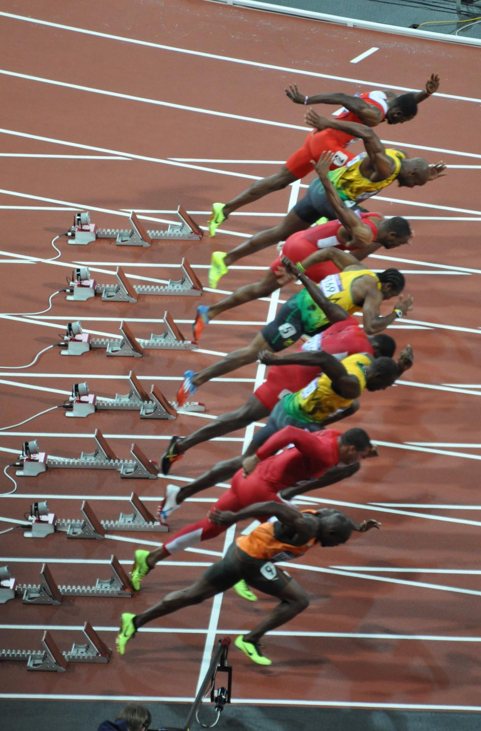
Year 11 – No Time to Waste
29 school weeks until start of exams
145 school days
130 lessons of English and 115 lessons of maths
A year of “this is the last time…”
Since their first day in reception in 2012, they’ve already done approx. 93% of the total number of school days they’ll ever do before they sit their exams

Slide 9

Year 11 – The Time to Step Up…
Our NUMBER ONE priority
Privileges … and expectations
Leaders of our school
Leading by example

Slide 10
Last week’s assembly – First day back
Helping you feel a bit less like this…
…and a bit more like this.

Slide 11
Year 11? Been there, done that.

Slide 12


Last week’s assembly – First day back
Why is it important for you to achieve well?
What happens in year 11?
How do I achieve well?

Slide 13

Why is it important for you to achieve well?
What do you want to do when you leave St Antony’s?
What career are you aiming for?
What course(s) do you want to study?
What qualifications do you need to access your chosen path?
What qualities and skills do you need?
Are you on track to get the qualifications you need to access your choices?

Slide 14


Why is it important for you to achieve well?
Qualifications open doors.
They are like keys to a better future.

Slide 15
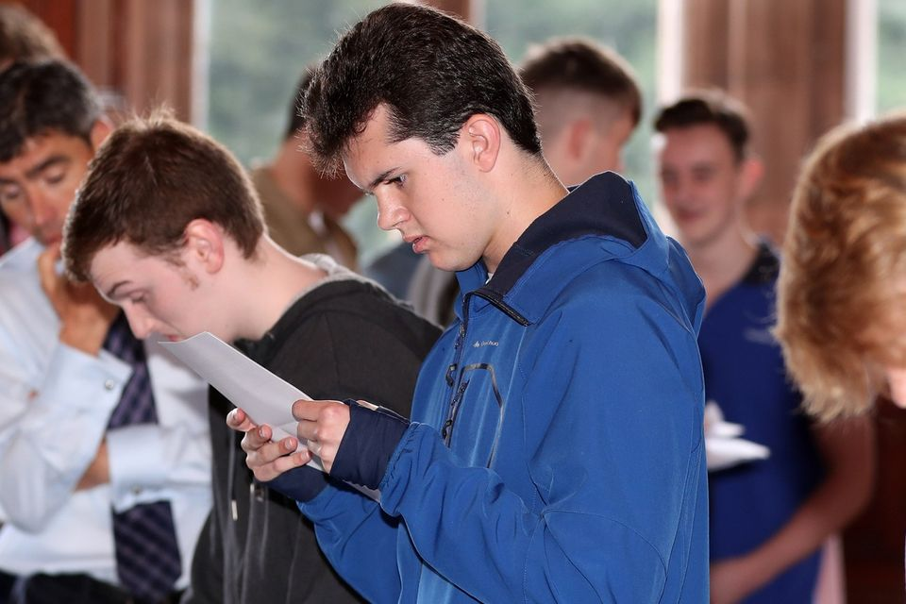
Something to think about...
What do you think happens after you get your CGSE results on 21st August 2025?

Slide 16

Why is it important for you to achieve well?
Shortlisting is a selection process undertaken by employers and education providers where they select applicants for a job or course.
A limited number of places exist, and a limited number of interviews can take place, so they will use application forms to select candidates.
Selection often includes:
  Does the candidate have the relevant qualifications at the right level?
  Did the candidate achieve well in English and Maths?
  How did the candidate achieve in their other subjects?
  What was the candidate’s attendance like?

Slide 17
Why is it important for you to achieve well?
Year 11 is about achieving well so that you can access the courses and careers that you want.

Slide 18
What happens in year 11?
Ongoing:
Lessons as usual. Still studying for qualifications.
Homework (structured revision) – Workbooks, revision guides, schedules.
P6, P0, independent Y11 study room (more information later).
Key dates:
November – Mocks round 1 (2 weeks).
December – College application deadline.
February – Mocks round 2 (2 weeks).
May/June – GCSE exams (5 weeks).
July – Prom (invite only).
August – Results day and enrolling for your next steps.
Notes:
.

Slide 19


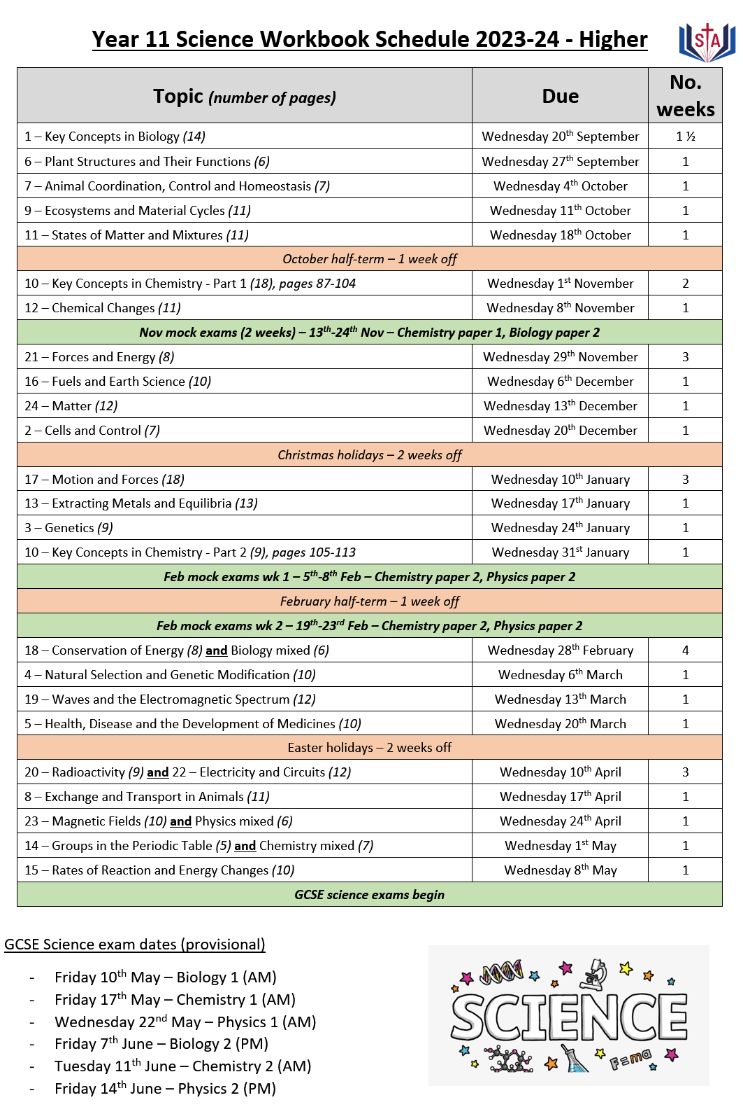
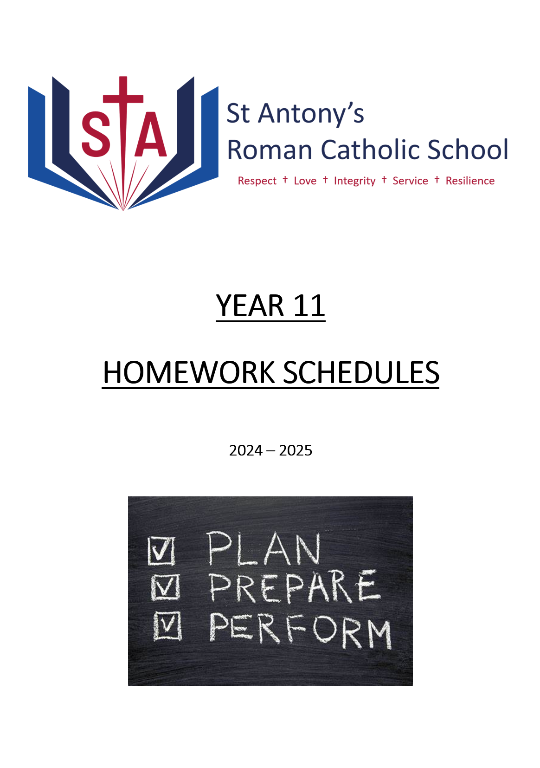

Year 11 homework – Structured revision
Revision guides provide the knowledge.
Workbooks provide the exam style questions.
A strategically mapped schedule to help students manage their time.

Slide 20
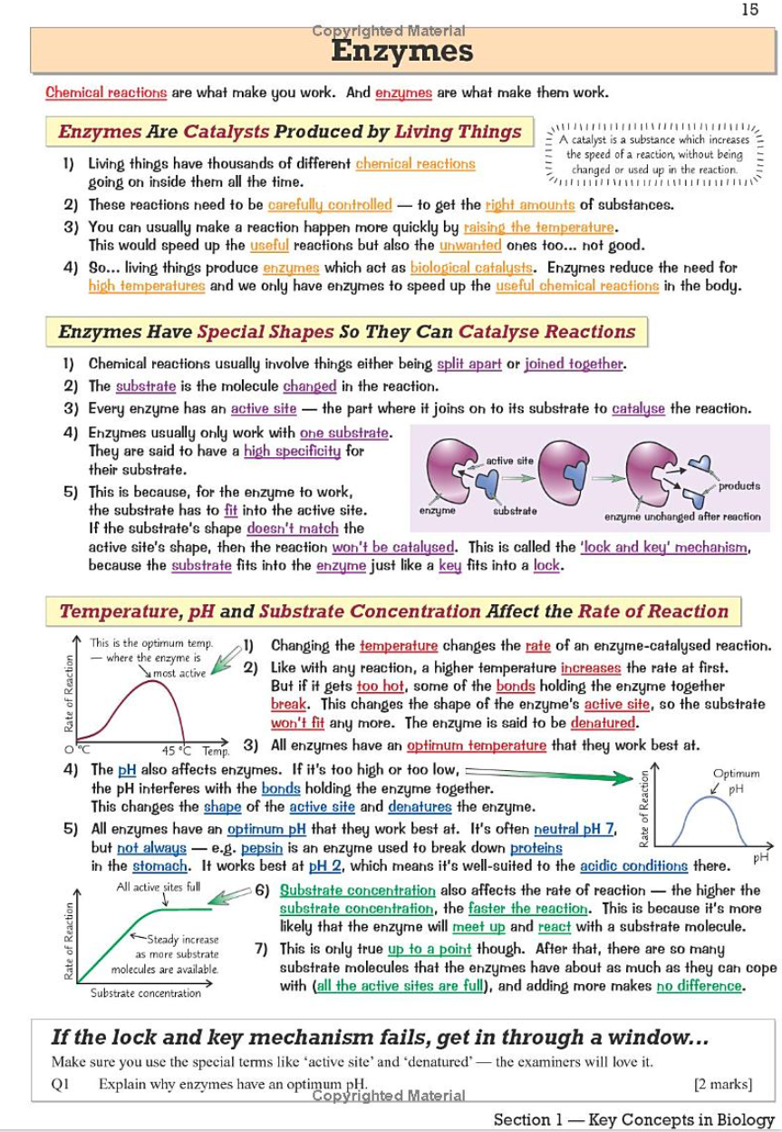
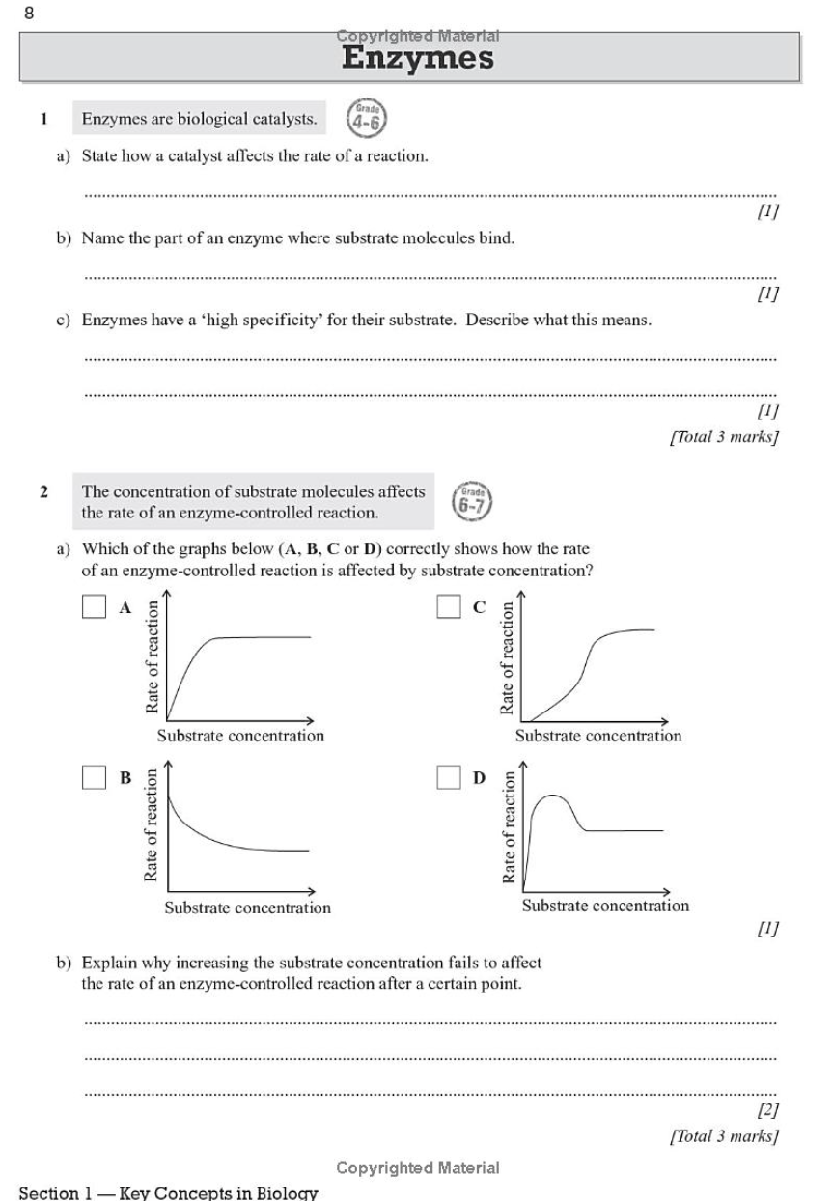
Year 11 homework – Structured revision
Revision Guide
Workbook
Tried, tested and PROVEN TO WORK

Slide 21
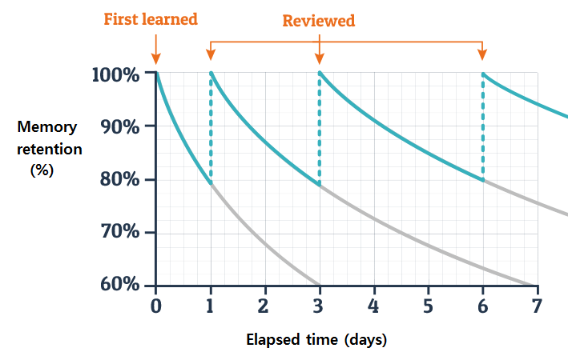
Year 11 homework – Structured revision

Slide 22
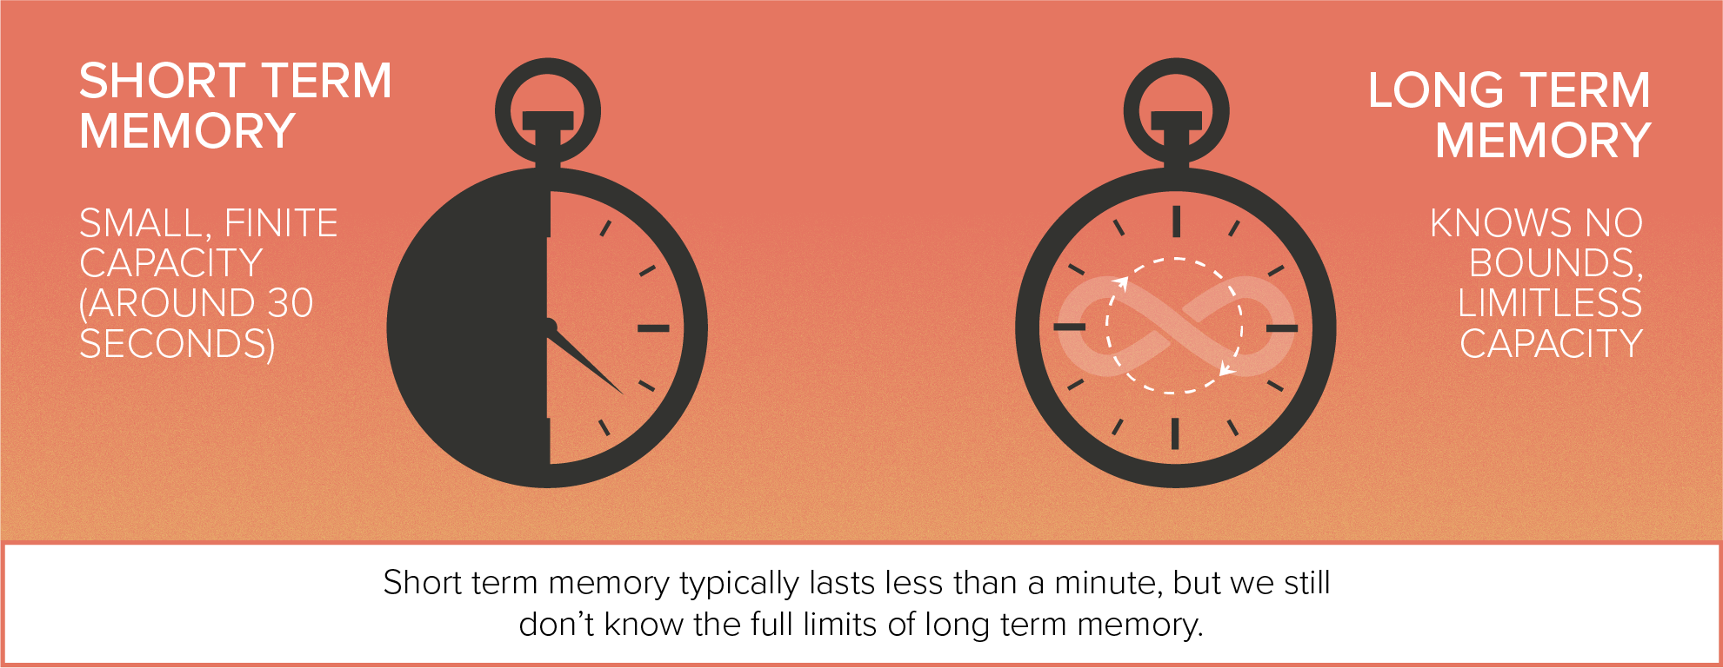
Year 11 homework – Structured revision

Slide 23
What happens in year 11?
Ongoing:
Lessons as usual. Still studying for qualifications.
Homework (structured revision) – Workbooks, revision guides, schedules.
P6, P0, Y11 independent study room.
Key dates:
November – Mocks round 1 (2 weeks).
December – College application deadline.
February – Mocks round 2 (2 weeks).
May/June – GCSE exams (5 weeks).
July – Prom (invite only).
August – Results day and enrolling for your next steps.

Slide 24
Period 6 – now the norm
3.15pm - 4.15pm
Extra bespoke help and support by subject teachers.
Massive impact for those pupils last year who attended regularly.
We provide biscuits!

Slide 25
Period 6 – now the norm
3.15pm - 4.15pm

Slide 26

P6, P0, Y11 independent study room
Y11 only independent study room, P6 every day in CR1. Staffed. Computers available.
Quiet, Y11 only space to work on homework or extra revision.

Slide 27
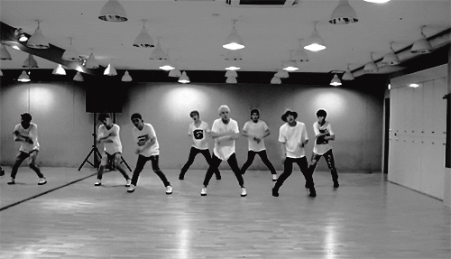
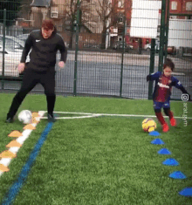

What happens in year 11?
Ongoing:
Lessons as usual. Still studying for qualifications.
Homework (structured revision) – Workbooks, revision guides, schedules.
P6, P0, Y11 independent study room.
Key dates:
November – Mocks round 1 (2 weeks).
December – College application deadline.
February – Mocks round 2 (2 weeks).
May/June – GCSE exams (5 weeks).
July – Prom (invite only).
August – Results day and enrolling for next steps.
Note: There is no study leave.
The best place for children is in lessons learning with the subject experts.
They leave when their exams are finished.

Slide 28

The GCSE Exams in Summer 2025
Students will sit in excess of 20 different exams during a 5-week period either side of the May Half Term break in 2025.

Slide 29

The GCSE Exams in Summer 2025
Most will gain 9 GCSE / Voc qualifications
4 exams in English Language & English Lit
3 exams in Maths
6 exams in Science
3 exams in RE
3 exams in History or 3 in Geography
Plus, more exams in their option subjects (how many depends on what they have selected)
Let’s look at what that 5-week period might be like for your child

Slide 30
Aims of the evening
What happens in year 11.
What your child needs to do to achieve well.
How you can support your child to achieve well.

Slide 31


Get what you want by studying hard
There’s nobody in this world that is going to get you what you want.
You’re going to have to go out there and get what you want by studying hard.

Slide 32

How do I achieve well?
Study hard – 100% effort, 100% of the time.

Slide 33

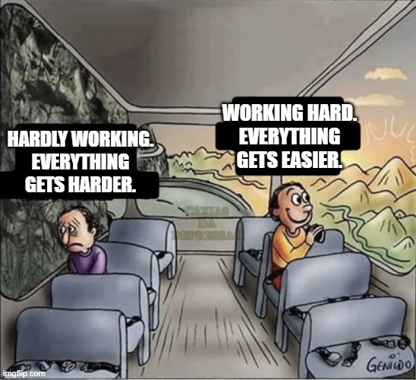
Attitude is everything

Slide 34

Stay positive
We sometimes
have to fail in
order to know how
to succeed.
So do not be afraid
when things go wrong.

Slide 35
2024 Results by Attitude to Learning
The following table shows the link between attitude to learning and the average grade for our 2024 leavers:
Attitude to Learning Groups | Average grade
Students with A to L scores of 4 with some 3s | 5.69
Students mainly with A to L scores of 3 with some 4s | 4.26
Students mainly with A to L scores of 3 or 2 | 3.04
Students mainly with A to L scores of 2 | 1.37

Slide 36

How do I achieve well?
Study hard – 100% effort, 100% of the time.
Positive attitude – Rise to the challenges you are presented with.

Slide 37

Something to think about...
Why do think attendance is so important?

Slide 38


The learning jigsaw
Each lesson is like a piece in a jigsaw.

Slide 39
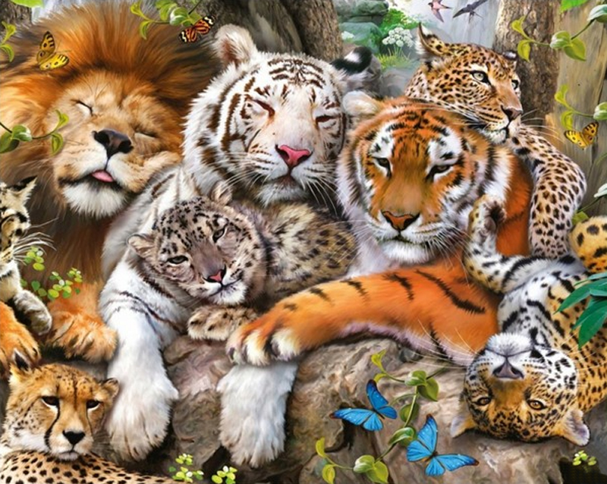

Slide 40
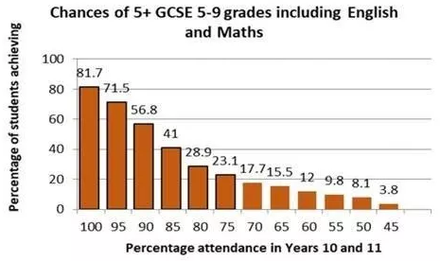

Slide 41
2024 Results by Attendance
The following table shows the link between attendance and the average grade for our 2024 leavers:
Group | Attendance | Average grade
1 | Students with 96.5% attendance or higher (1-week absence or less) | 4.78
2 | Students with 93% - 96.5% attendance (between 1 and 2-weeks absence) | 4.12
3 | Students with 90% - 93% attendance (between 2 and 3-weeks absence) | 3.94
4 | Students with 80% - 90% attendance (between 5 and 3-weeks absence) | 3.46
5 | Students with attendance below 80% | 1.89

Slide 42

How do I achieve well?
Study hard – 100% effort, 100% of the time.
Positive attitude – Rise to the challenges you are presented with.
Attend everything – Lessons, form, period 6. All part of the jigsaw.

Slide 43
2024 Results by Homework
The following table shows the link between homework and the average grade for our 2024 leavers:
Homework Groups | Average grade
Students mainly with homework scores of 4 and 3 | 5.90
Students mainly with homework scores of 3 with some 4s | 4.25
Students mainly with homework scores of 3s and 2s | 3.04
Students mainly with homework scores of 2 | 1.62

Slide 44
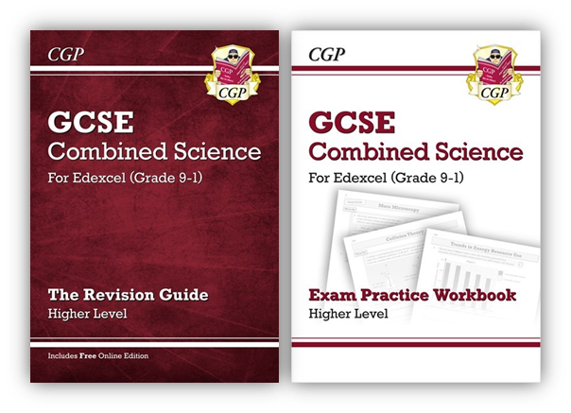
How do I achieve well?
Study hard – 100% effort, 100% of the time.
Positive attitude – Rise to the challenges you are presented with.
Attend everything – Lessons, form, period 6. All part of the jigsaw.
Homework (revision) – Complete it properly and on time.

Slide 45
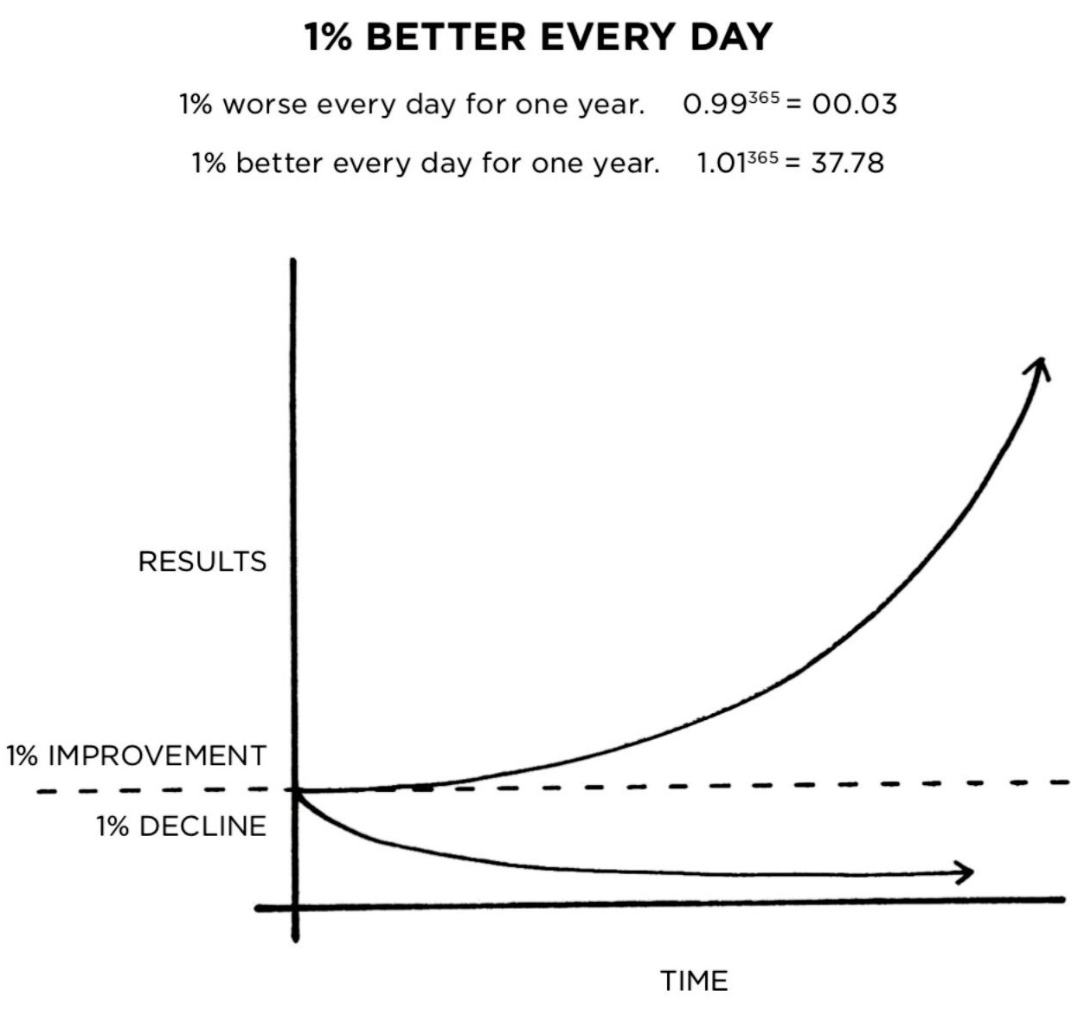
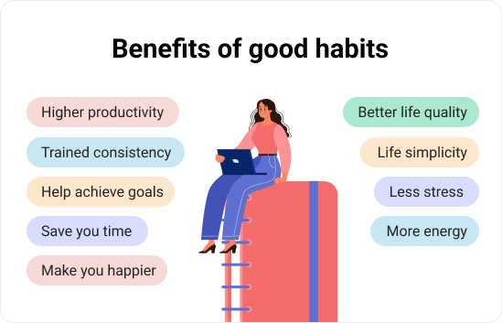
Build good habits
Eat breakfast.
Arrive on time.
Concentrate on learning.
Avoid distractions.
Listen carefully to your teachers.
Complete all work with 100% effort.
Complete your homework as soon as you get home, BEFORE relaxing.
Study at home with your phone switched off.
Get a good night’s sleep.

Slide 46
2024 Results by Reading
The following table shows the link between reading and the average grade for our 2024 leavers:
Reading age | Average grade
17 years | 5.23
16 years | 4.87
15 years | 4.16
14 years | 3.90
13 years | 3.96
12 years | 3.74
11 years | 3.03
10 years and below | 2.73

Slide 47
How do I achieve well?
Study hard – 100% effort, 100% of the time.
Positive attitude – Rise to the challenges you are presented with.
Attend everything – Lessons, form, period 6. All part of the jigsaw.
Homework (revision) – Complete it properly and on time.
Build good habits – Small positive choices become automatic.

Slide 48
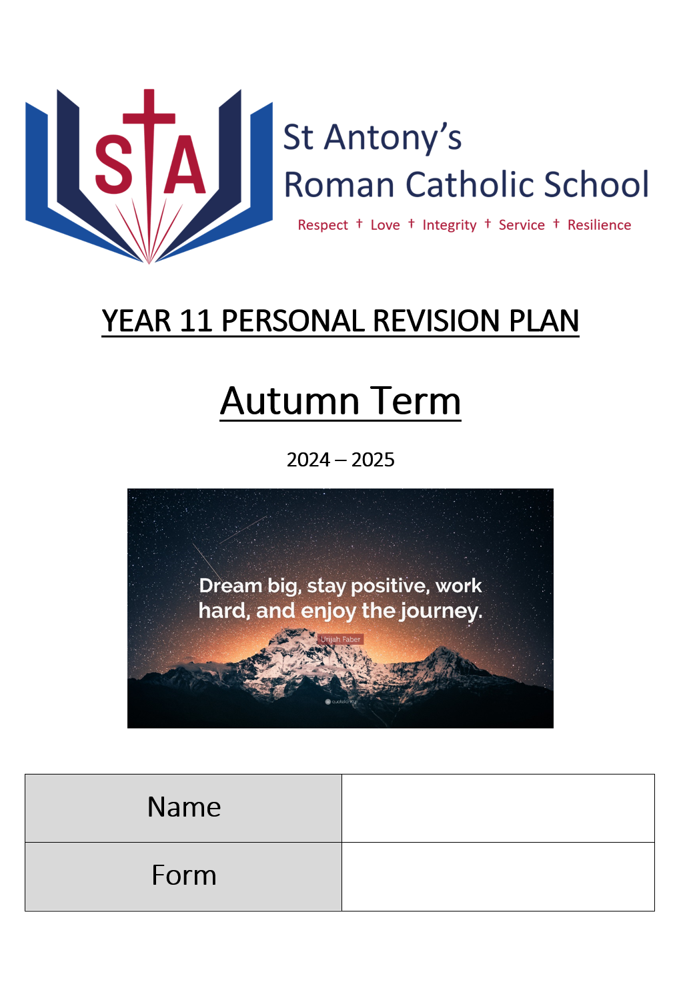
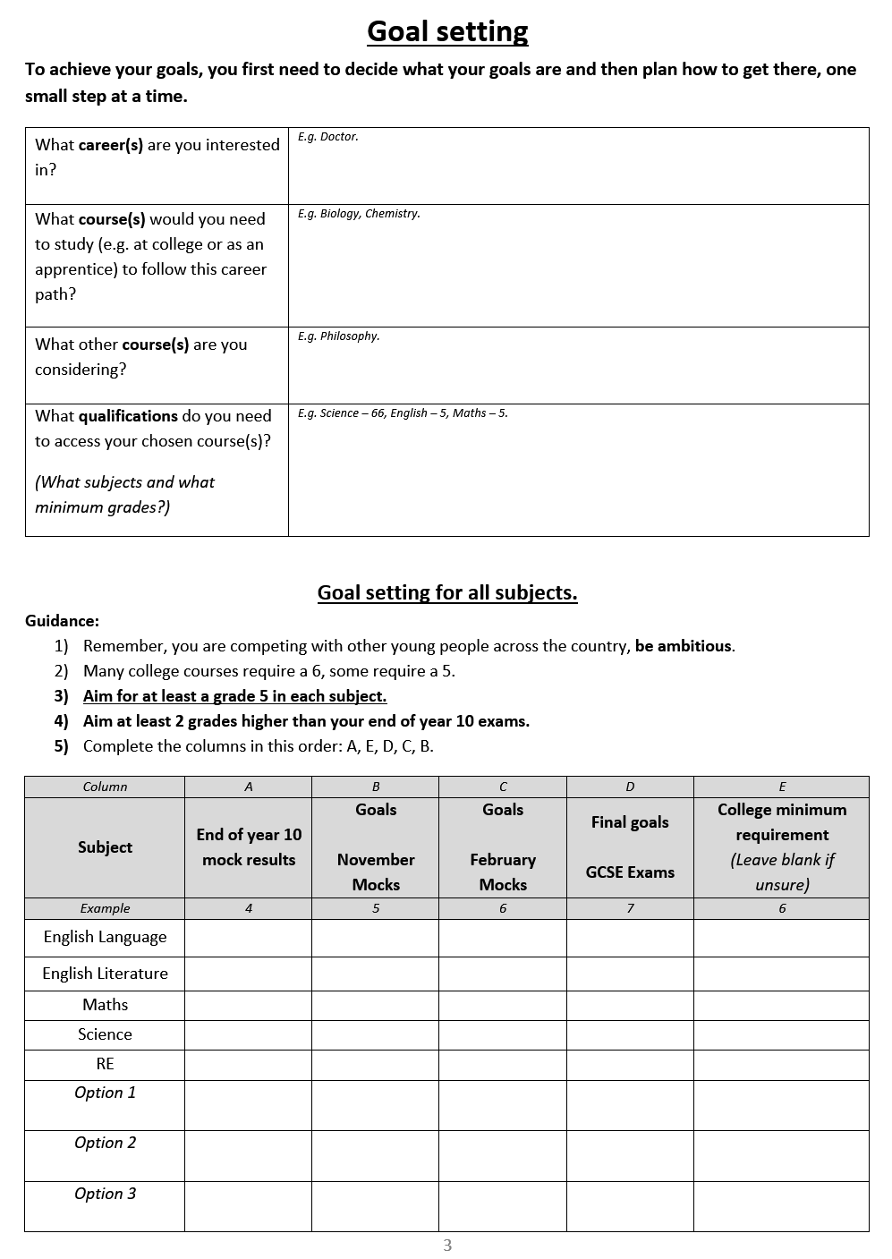
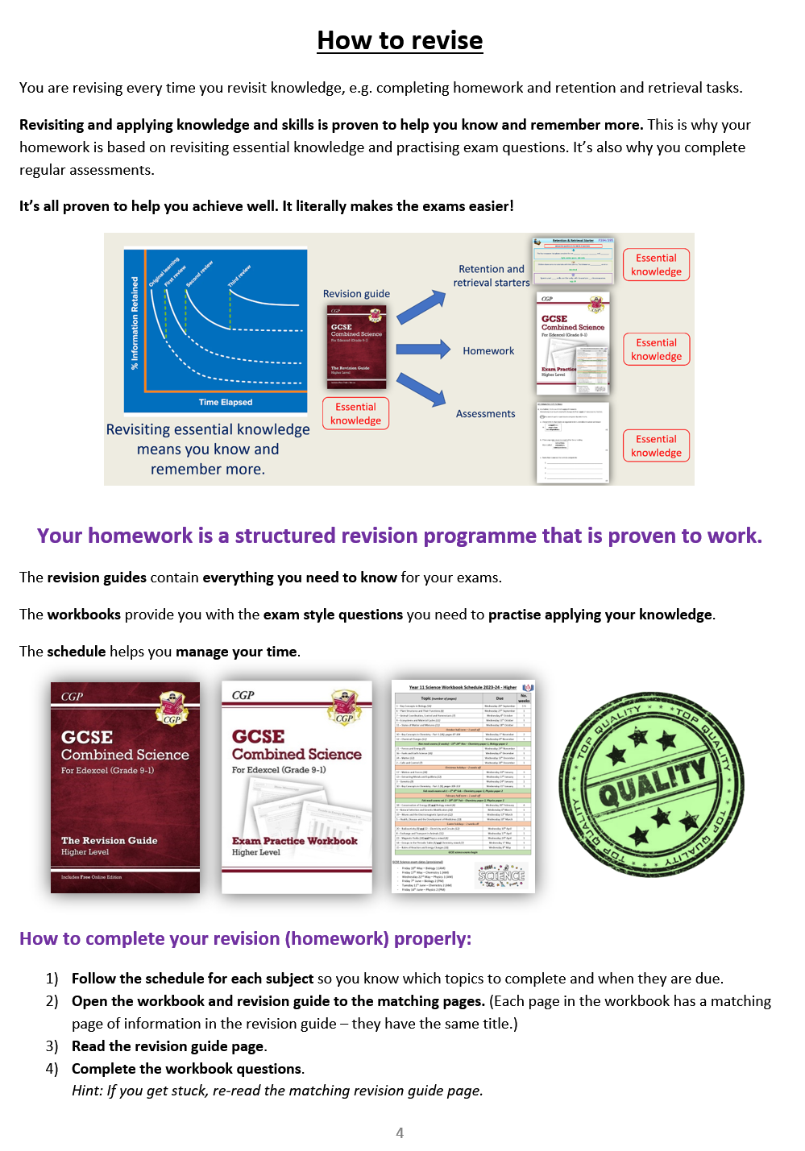
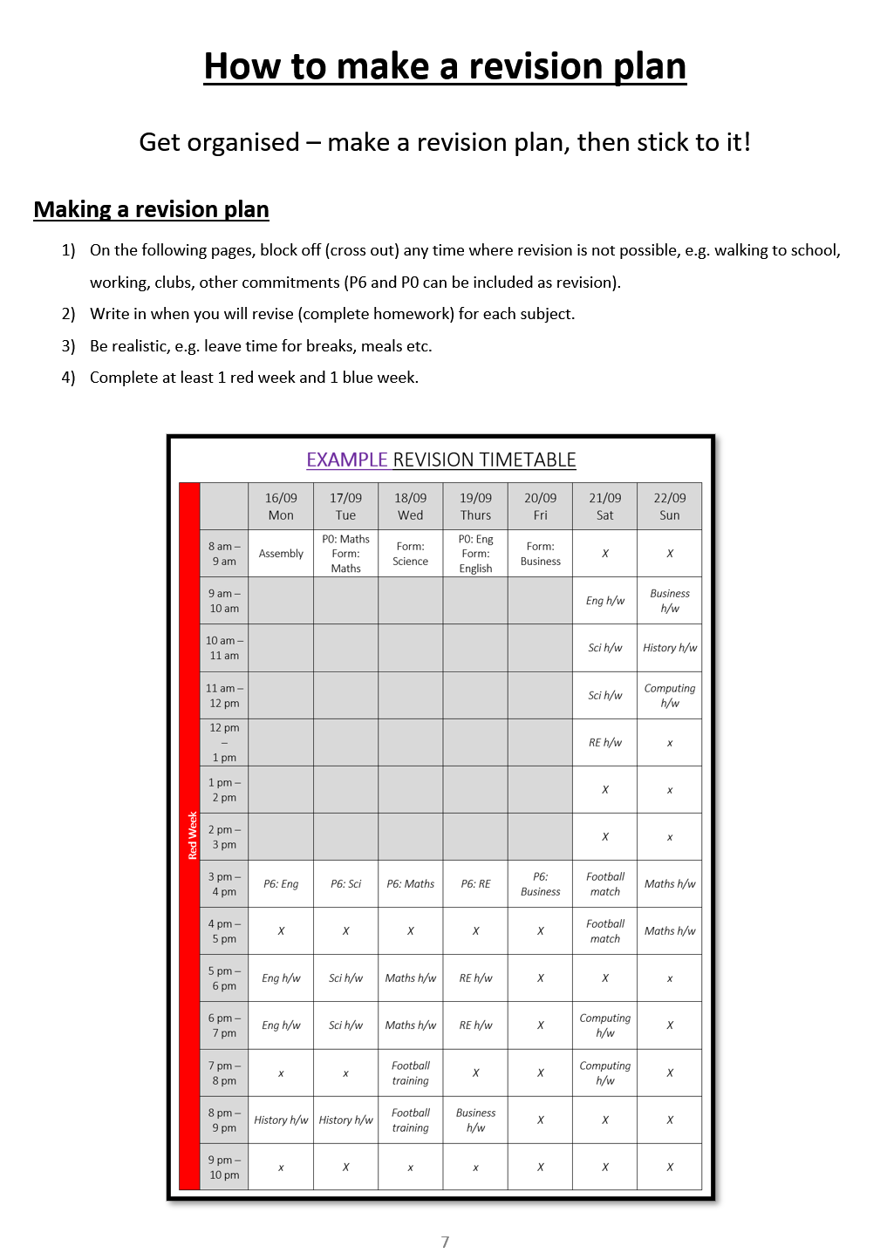
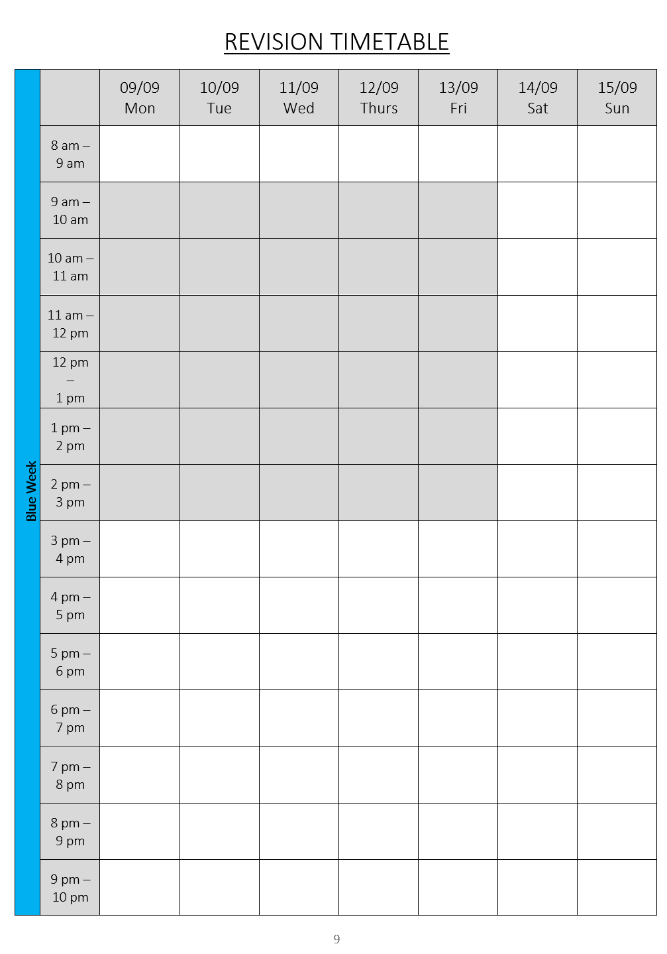
Be organised
During extended form time, pupils set key goals, then created a personal revision plan to help them organise their time to achieve those goals.
This will help them to build good habits.

Slide 49
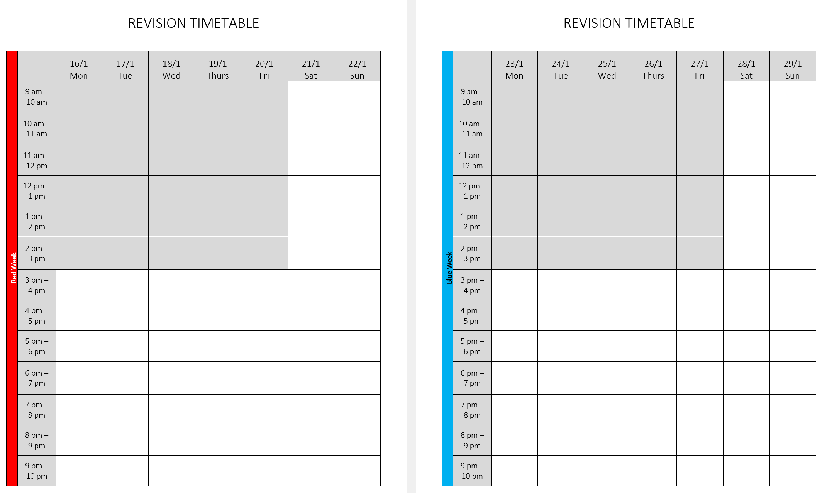
How do I achieve well?
Study hard – 100% effort, 100% of the time.
Positive attitude – Rise to the challenges you are presented with.
Attend everything – Lessons, form, period 6. All part of the jigsaw.
Homework (revision) – Complete it properly and on time.
Build good habits – Small positive choices become automatic.
Be organised – Make a plan and stick to it.

Slide 50

How do I achieve well?
Study hard – 100% effort, 100% of the time.
Positive attitude – Rise to the challenges you are presented with.
Attend everything – Lessons, form, period 6. All part of the jigsaw.
Homework (revision) – Complete it properly and on time.
Build good habits – Small positive choices become automatic.
Be organised – Make a plan and stick to it.
Seize opportunities – P6, P0, Y11 independent study room.

Slide 51

Resilience - When times get hard, work harder

Slide 52

How do I achieve well?
Study hard – 100% effort, 100% of the time.
Positive attitude – Rise to the challenges you are presented with.
Attend everything – Lessons, form, period 6. All part of the jigsaw.
Homework (revision) – Complete it properly and on time.
Build good habits – Small positive choices become automatic.
Be organised – Make a plan and stick to it.
Seize opportunities – P6, P0, Y11 independent study room.
Resilience - When times get hard, work harder. Then work harder. Then work even harder. No excuses.

Slide 53
Aims of the evening
What happens in year 11.
What your child needs to do to achieve well.
How you can support your child to achieve well.

Slide 54
Supporting your child to achieve well – Core Subjects
You’re going to hear now from:
Head of English
Head of Maths
Head of Science
Head of RE
All children are undertaking qualifications in these subjects so it’s important that you know what your child needs to do to achieve well.

Slide 55


Slide 56
GCSE
English Language
&
English Literature

Slide 57
English Language features two exams:
Paper 1 – reading one fiction source; writing creatively
Paper 2 – reading two non-fiction sources; writing discursively (viewpoints)
Students will also have to complete a Spoken Language Endorsement assessment, involving a presentation which we have to record this year.
Paper 1 → 50%
Reading = 1 hour
Writing = 45 minutes
Paper 2 → 50%
Reading = 1 hour
Writing = 45 minutes

Slide 58
English Language features two exams:
Paper 1 – Macbeth and The Strange Case of Dr Jekyll and Mr Hyde
Paper 2 – An Inspector Calls, Power & Conflict poetry, and Unseen Poetry
No ‘optional’ elements this year.
Paper 1 → 40%
1 hour 45 mins
Section A and B – roughly 50 mins each
Paper 2 → 60%
2 hours 15 mins
A, B and C – roughly 45 mins each

Slide 59
Preparing For The English Exams
Y11 English homework programme- all revision guides will be provided, and we will guide students in how best to use them
Think about how the revision guides can support you as a parent
Re-reading each text is great revision
Focus on poetry- 15 poems to learn, this can feel overwhelming
Ask your child to have key quotes from the texts around their room or even around the house
Help your child to create a revision timetable that covers all aspects of the English Literature and Language courses and check, as much as you can, that they are trying to stick to this.

Slide 60

Mathematics

Slide 61
GCSE Maths
Pearson Edexcel exam board
Three exam papers
  One will be a non-calculator paper (33%)
  Two papers will require the use of a calculator (33% each)
Pupils should have their own Casio calculator and should bring it to all Mathematics lessons with them.

Slide 62
Homework
Using the revision workbooks – due every Tuesday
Additional practise set on drfrost.org

Slide 63
P0/P6
Multiple opportunities to attend before or after school.
We can help!

Slide 64
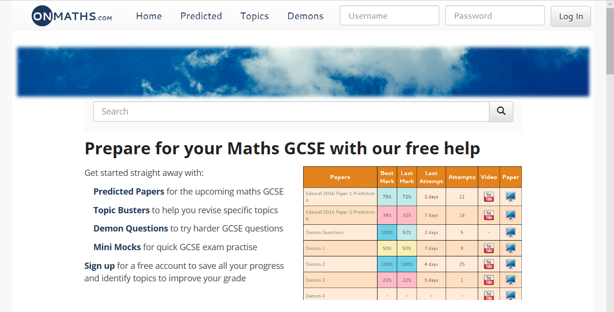
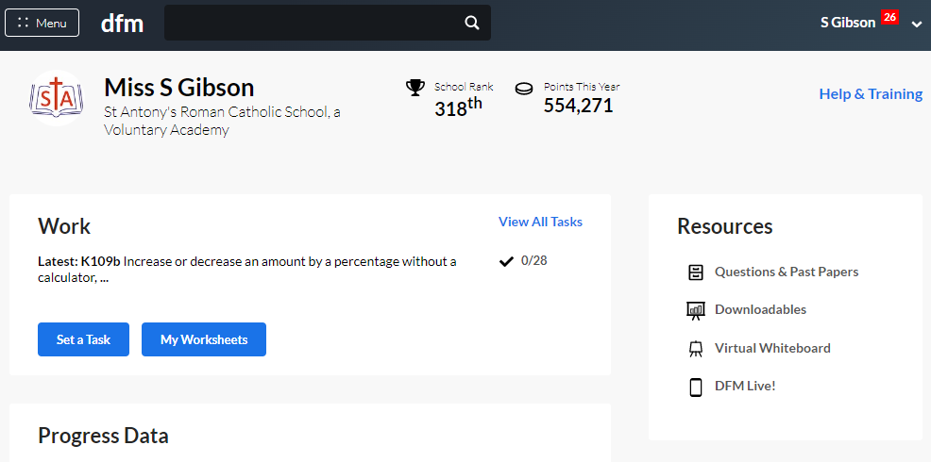
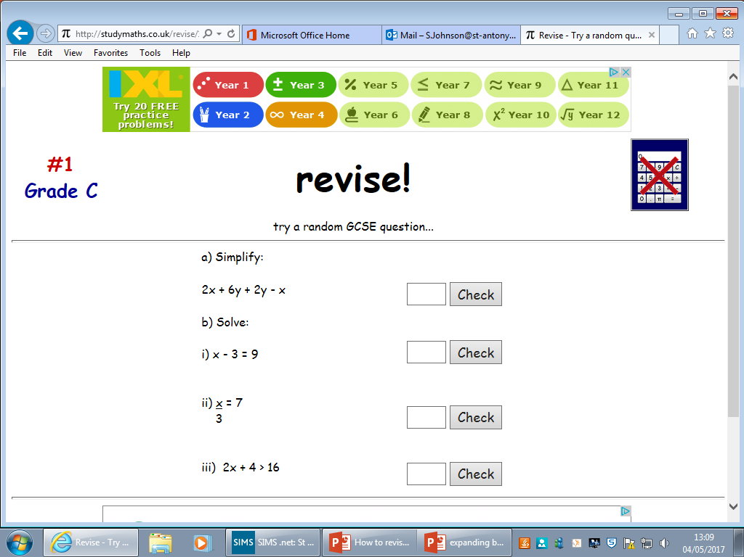
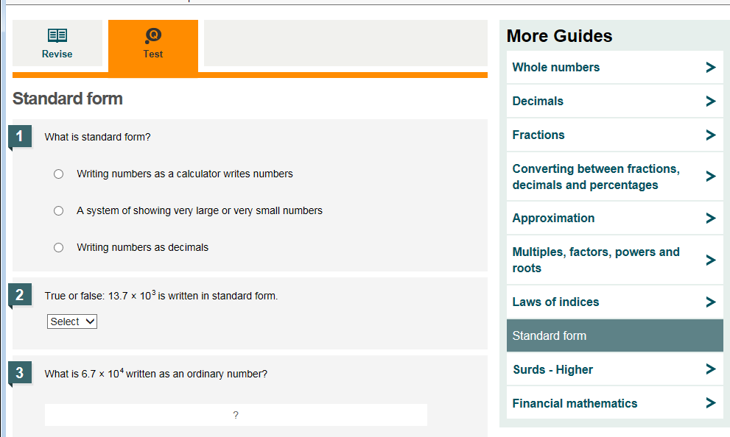
onmaths.com
www.drfrostmaths.com
Online
Mark your answers for you
Instant feedback
BBC bitesize
Studymaths.co.uk

Slide 65

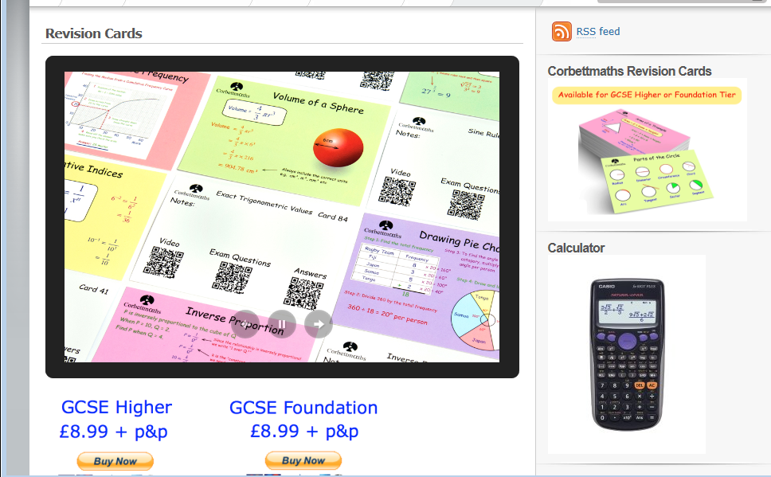
Cognitoedu.org
corbettmaths

Slide 66
How Else Can You Help Your Child?
Firstly, don’t panic, we don’t expect you to be an expert in Maths!
You are, however, an expert in your child!
Please don’t trash talk Maths!
‘I was never any good at Maths’ ‘I hated Maths at school’
If they want or are willing to have your support, ask them what they know about the topic, to explain it to you. Watch a video on one of the website. It’s all about problem solving – see if you can be a study buddy.
Display formulae to be learnt around the house & check they can recall it
…and if you have any questions after tonight,
please email me at s.gibson@st-antonys.com or your child’s Maths teacher

Slide 67


Slide 68


Science – What’s involved?
6 science papers.
Combined Science – 6 x 1h 10 mins.
Triple Science – 6 x 1h 45 mins.
Foundation or higher.

Slide 69


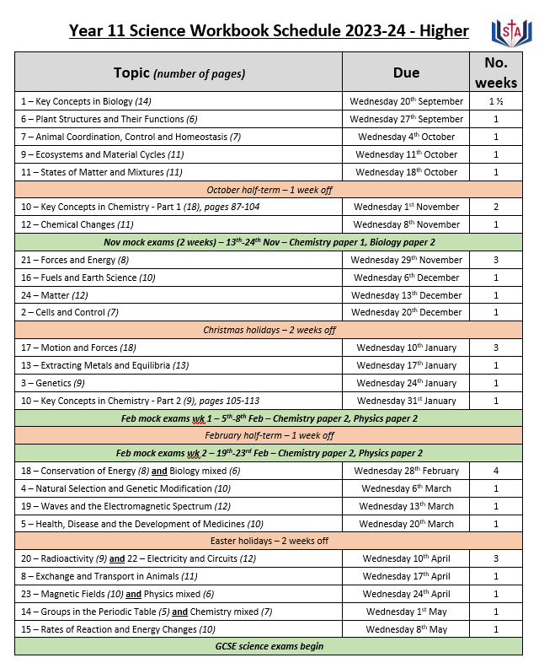
How to complete science homework

Slide 70
Extra science revision
Seneca website. Log in using your school login. Add the GCSE Edexcel Science courses and use these for extra revision.
Flashcards available on the CGP website.
Cognito Science Free Maths & Science Revision and Past Papers for A-Level, GCSE and KS3 | Cognito (cognitoedu.org)
GCSE Combined Science - Edexcel - BBC Bitesize - lots of useful revision pages, video clips and quizzes.
https://www.youtube.com/freesciencelessons - The guy in the blue suit. Short videos that explain concepts clearly and get to the point.

Slide 71
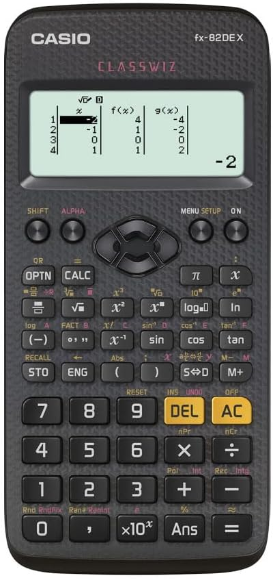
Science P6
Takes place on a blue Wednesday.
Opportunity to:
Practise required practicals.
Receive support with homework.
Go through anything they’re stuck on.

Slide 72

How to succeed in Religious Studies

Slide 73
GCSE Religious Studies
Paper 1
Paper 2
Paper 3
Foundational Catholic Theology
Origins and Meaning
Good and Evil
Applied Catholic Theology
3. Life and Death
4. Sin and Forgiveness
Study of Judaism
Beliefs and Teachings
Practices
37.5% of final grade
1 x 90 minute paper
37.5% of final grade
1 x 90 minute paper
25% of final grade
1 x 60 minute paper

Slide 74

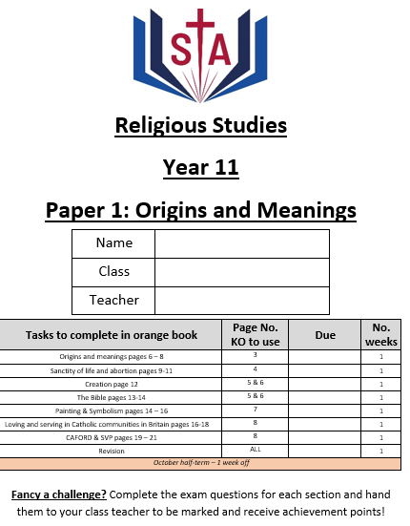
How do I complete homework?

Slide 75




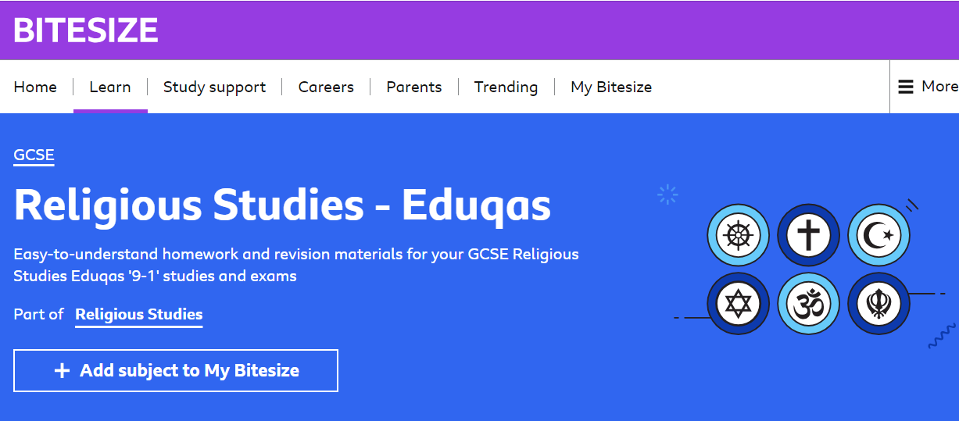

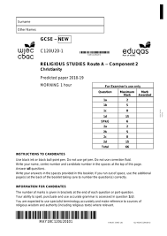
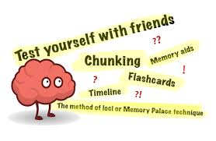
How can I revise for RE?

Slide 76
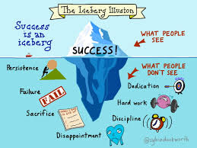
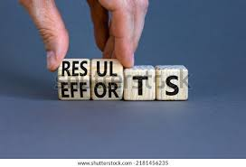
Why it’s important to attend your P6/P0?
Specialist teacher to guide you through any topic you need help with.
Access to exam skills sessions to develop particular skills to boost your grade.
Opportunity to revise as a team.
P6
Takes place in CR2 on RED Fridays
P0
Takes place in room 14 and 15 on RED Fridays

Slide 77
Excellence in RE
Attend lessons & interventions
Work hard
Revise

Slide 78
Aims of the evening
What happens in year 11.
What your child needs to do to achieve well.
How you can support your child to achieve well.

Slide 79


Attendance & Punctuality
The GCSE results from the summer reinforced a key fact – that the more pupils attend school, the better their outcomes
Please do everything you can to ensure your child attends school every day.
If a pupil has an overall attendance of 95%, this may sound good, yet it actually means the pupil will have missed 9 days of lessons, which is nearly 45 hours of input from their class teachers that they will never get back – plus lost opportunities for intervention and support.
If pupils are not in, we cannot help them.
Please avoid appointments, meetings etc during the school day.

Slide 80

Attendance & Punctuality
Pupils should be in school, ready for the day by 8:45am. Once the second bell has gone at 8:50am… they are LATE!
Registration is where pupils will be given:
Support from their form tutor
Important information relevant for Y11s
Careers advice and information about colleges and apprenticeships
Revision guidance
Support with reading if it is needed
Some subject specific interventions
….they have to attend!

Slide 81
Your role in supporting your child’s GCSE outcomes
Make sure your child attends school every day.
Make sure your child arrives to school on time.
Ensure any routine medical appointments are made outside of school hours.
Check their homework daily.
Remember that holidays are only a break from attending school and pupils should not see it as a break from work. They should be completing some form of work or revision EVERY DAY.
Ensure your child has access to a quiet space that is conducive for work and revision.
If you have any concerns at all about your child, then your first point of contact should be with their Form Tutor.
Encourage your child to take advantage of all of the extra facilities offered in support of their studies.
Encourage your child to complete their homework as soon as it is set.
Help your child avoid “time eaters” – phones away when revising or going to sleep.

Slide 82
Organisation & homework
Support your child with being organised by:
Making sure they are following their revision timetable.
Making sure they are completing their homework on time.
Checking they are leaving the house with what they need for the day.
All year 11 pupils need revision (homework) with them every Thursday and Friday to complete in form. This is a Y11 privilege.

Slide 83
Your role in supporting your child’s GCSE outcomes
Make sure your child attends school every day.
Make sure your child arrives to school on time.
Ensure any routine medical appointments are made outside of school hours.
Check their homework daily to help them with organisation.
Remember that holidays are only a break from attending school and pupils should not see it as a break from work. They should be completing some form of work or revision EVERY DAY.
Ensure your child has access to a quiet space that is conducive for work and revision.
If you have any concerns at all about your child, then your first point of contact should be with their Form Tutor.
Encourage your child to take advantage of all of the extra facilities offered in support of their studies.
Encourage your child to complete their homework as soon as it is set.
Help your child avoid “time eaters” – phones away when revising or going to sleep.

Slide 84
P6, P0, Y11 independent study room
Y11 only independent study room, P6 every day in CR1. Staffed. Computers available.
Quiet, Y11 only space to work on homework or extra revision.

Slide 85
Your role in supporting your child’s GCSE outcomes
Make sure your child attends school every day.
Make sure your child arrives to school on time.
Ensure any routine medical appointments are made outside of school hours.
Check their homework daily to help them with organisation.
Remember that holidays are only a break from attending school and pupils should not see it as a break from work. They should be completing some form of work or revision EVERY DAY.
Ensure your child has access to a quiet space that is conducive for work and revision.
If you have any concerns at all about your child, then your first point of contact should be with their Form Tutor.
Encourage your child to take advantage of all of the extra facilities offered in support of their studies.
Encourage your child to complete their homework as soon as they get home.
Help your child avoid “time eaters”.

Slide 86




Help your child avoid “time eaters”
What is eating your child’s time?
How much of your child’s time is eaten each day?
How much time each week?
How much easier would your child find school if this time was spent studying?
Completing homework as soon as your child arrives home, BEFORE falling down a rabbit hole that time eaters provide, will help your child be successful this year.

Slide 87


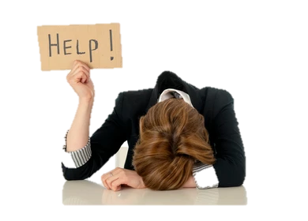

How Else Can You Support Your Child?
Patience
Love
Care
Support
Understanding
Guidance

Slide 88


Slide 89

Parents’ Pack
Summary explaining how parents can help
Tips for your child to achieve well
Key dates for Year 11 for the year ahead
Useful contacts
Managing exam stress
General revision tips
Extra revision resources from different subjects
Blank revision timetable
Information on new 9-1 grades for GCSEs
Satchel-one guide for parents / pupils
Exam schedule for summer 2025 (subject to change)
Homework schedules for all subjects
Spare revision booklet with weekly timetable
End of year 10 report

Slide 90


Slide 91


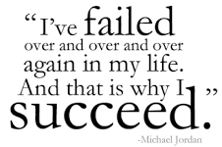

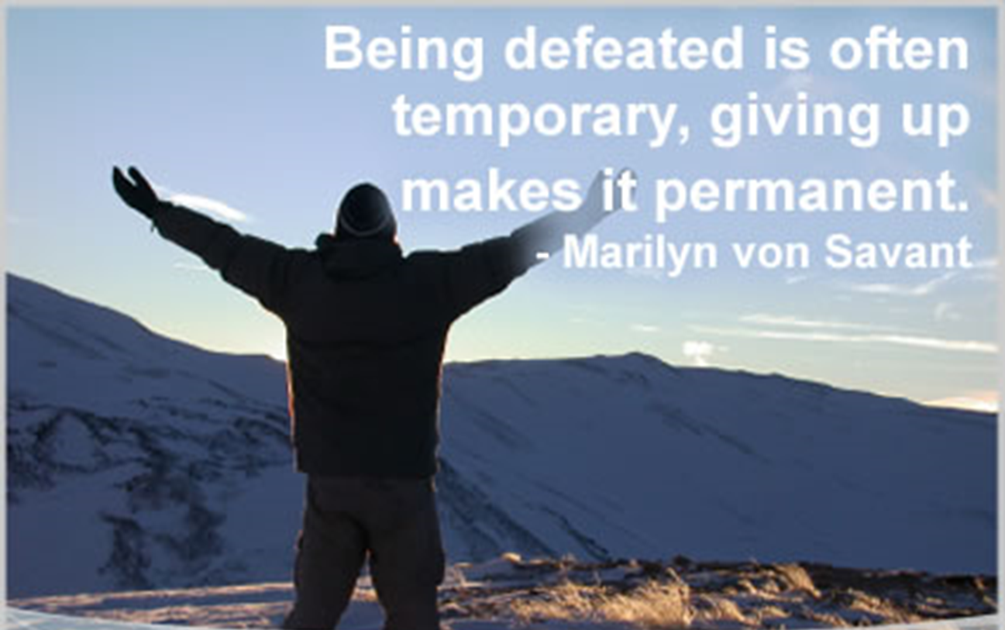
Failure & Difficulty:
Normal Part of Y11 Experience

Slide 92
High Standards at All Times
Behaviour – in lessons and out of lessons
Uniform
Attendance
Punctuality
How they interact with adults & each other
Remember:
Learning is top of our agenda in school

Slide 93

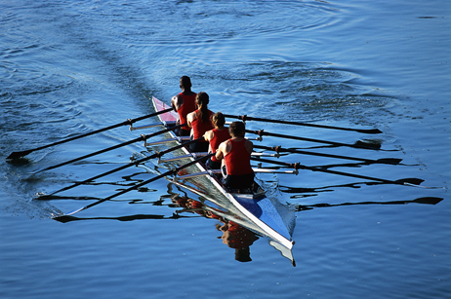
Final Comments

Slide 94

Final Comments

Slide 95
Your Support Makes a HUGE Difference…

Slide 96
Year 11, this is YOUR year

Slide 97

Notes:
VIDEO

Slide 98



