Slide 1
PARENT / CARER INFORMATION EVENING
YEAR 8
25TH SEPTEMBER 2024
Please complete the OFSTED parent view by scanning the QR code

Slide 2
STA
AIMS
AGENDA
In line with our mission statement, our overall aim is for all pupils to be the best versions of themselves
How we can support each other to give your child the best chance of success
What’s ahead – what’s involved in this really important, foundation year?

Slide 3
WHAT DO WE WANT FOR OUR STUDENTS?

Slide 4
OUR NUMBER ONE PRIORITY AT STA
HOW DO WE TACKLE OUR NUMBER ONE PRIORITY?

Slide 5
YOUR SUPPORT MAKES A HUGE DIFFERENCE…
Class of
2028

Slide 6
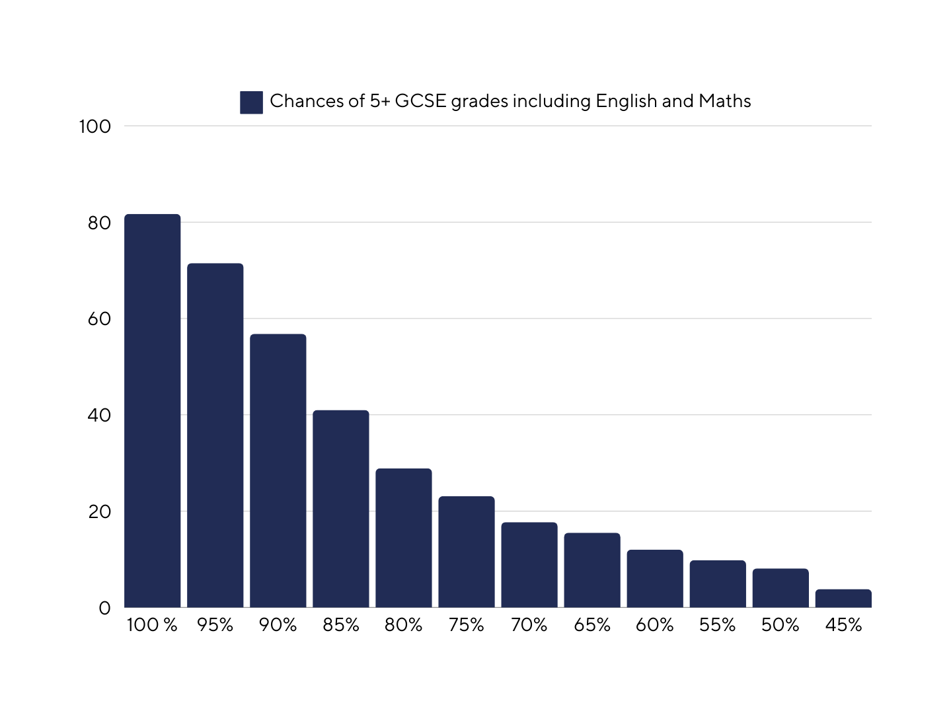
ATTENDANCE
If a pupil has an overall attendance of 95%, this may sound good, yet actually it’s 9.5 days of missed lessons which equals nearly 50 hours of input from their class teachers.

Slide 7
STA 2024 RESULTS BY ATTENDANCE
Students with 96.5% attendance or higher (1-week absence or less)
→ Average Grade: 4.78
Students with 93% - 96.5% attendance (between 1 and 2 weeks absence)
→ Average Grade : 4.12
Students with 90% - 93% attendance (between 2 and 3 weeks absence)
→ Average Grade: 3.94
Students with 80% - 90% attendance (between 5 and 3 weeks absence)
→ Average Grade: 3.46
Students with attendance below 80%
→ Average Grade: 1.89

Slide 8
PUNCTUALITY
AGENDA
If a student arrives late to school, they will receive a 30-minute C3L late detention after school on the same day. You will be notified accordingly.
Your child must register with their Form tutor at 8:45 am. This is a legal requirement. If your child arrives to school after 8:50 am then they MUST sign-in at the side gate (bus bay).
If they arrive after 9:05 am they MUST sign in at the main reception.
If you are aware that your child will be late to school due to specific circumstances, please inform us.

Slide 9
YOUR ROLE IN SUPPORTING THEIR EDUCATION

Slide 10
THE GCSE EXAMS IN SUMMER 2028
Most will gain 9 GCSE / Voc qualifications
4 exams in English Language & English Lit
3 exams in Maths
6 exams in Science
3 exams in RE
3 exams in History or 3 in Geography
Plus more exams in their other option subjects (how many depends on what they have selected)

Slide 11
LOOKING AHEAD
•All pupils choose 3 options
•All pupils must choose either Geography or History
•We shall be pushing the Ebacc qualification (English, Maths, Science, a humanity and a language)
•We have heavily invested in our languages department

Slide 12
THE YEAR 8 CURRICULUM
Our Year 8 curriculum builds on the foundations laid in Year 7 and is part of our ambitious, 5-year spiral curriculum. We place significant emphasis on the retention and retrieval of key knowledge as well as reading and literacy skills. Our subject offer for Year 8 across two weeks this year is as follows:
•English – 7 lessons
•Maths – 7 lessons
•Science – 6 lessons
•RE – 5 lessons
•Art – 2 lessons
•Computer Science – 2 lessons
•Geography – 3 lessons
•History – 3 lessons
•Music – 2 lessons
•Personal Development – 2 lessons
•PE – 2 lessons
•Spanish – 4 lessons
•In addition, reading takes place in form time

Slide 13
PERSONAL DEVELOPMENT CURRICULUM
Autumn Term | Spring Term | Summer Term
·Created and chosen ·What are the Gatsby Benchmarks? ·Self-management skills ·Appreciating differences ·Relationship values & disagreeing respectfully ·Relationship expectations & gender stereotypes ·Gender identity & sexuality ·Intro to community diversity ·Giving and seeking permission ·Consent - avoiding assumptions ·Appropriate and inappropriate touching ·Rights up your street - human rights ·‘Before I was born’ | ·Formalising relationships ·Managing conflict ·When families separate ·Tough relationships ·Gender pay gap ·Gender equality ·Fake news and media literacy ·E safety ·Nudes ·How can we make a difference? | ·Stereotyping and prejudice ·Inclusive language ·Disability inclusion ·Visible differences ·Diversity and celebrating differences ·Why should local elections matter to you? ·Stress ·Ander and jealousy ·Dealing with fear ·Safeguarding against extremism

Slide 14
REPORTS HOME TO YOU
December Interim Report | April Interim Report | July Full report​
•Attitude to learning score​ •Homework score​ •Attendance​ •Punctuality​ •Reward points​ •Behaviour points​ •In each subject, a percentage showing how much of the essential knowledge has been retained | •Attitude to learning score​ •Homework score​ •Attendance​ •Punctuality​ •Reward points​ •Behaviour points​ •In each subject, a percentage showing how much of the essential knowledge has been retained | •Attitude to learning score​ •Homework score​ •Attendance​ •Punctuality​ •Reward points​ •Behaviour points​ •​In each subject, a percentage showing how much of the essential knowledge has been retained •Written comments from teachers​

Slide 15
HOW DO PUPILS ACHIEVE WELL AT STA?

Slide 16
STA 2024 RESULTS BY ATTITUDE TO LEARNING
Students with A to L scores of 3 with some 4s
→ Average Grade: 4.26
Students with A to L scores of 4 with some 3s
→ Average Grade: 5.69
Students with A to L scores of 3 or 2
→ Average Grade: 3.04
Students with A to L scores of 2
→ Average Grade: 1.37

Slide 17
THE PURPOSE OF HOMEWORK
Knowing more and remembering more means students can do more.
Students can achieve higher, reach their potential and access their college courses.
Knowing more and remembering more makes lessons easier, tests easier, and exams easier.
Supports students to become independent and resilient.
Help students know and remember more.

Slide 18
HOW TO SUPPORT YOUR CHILD COMPLETING HOMEWORK

Slide 19
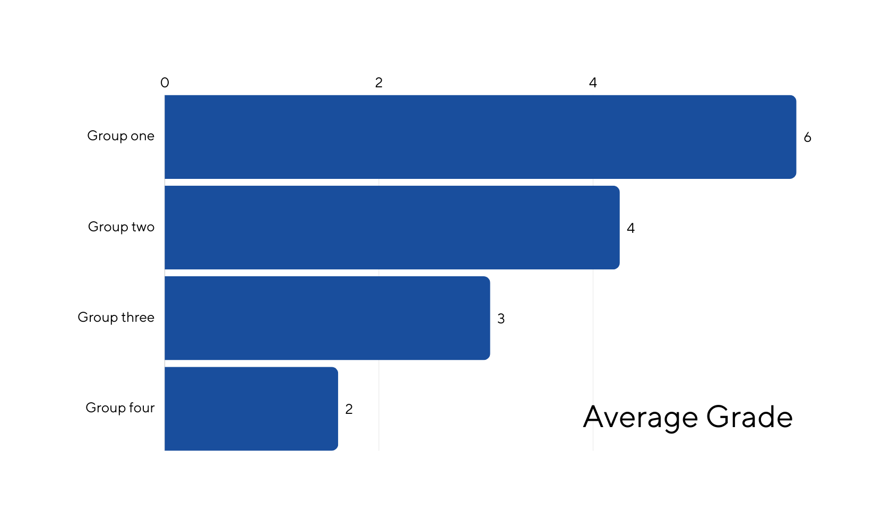
STA 2024 RESULTS BY HOMEWORK
Students mainly with homework scores of 4 and 3
Average Grade - 5.90
Students mainly with homework scores of 3 with some 4s
Average Grade - 4.25
Homework score
Students mainly with homework scores of 3s and 2s
Average Grade - 3.04
Students mainly with homework scores of 2 Average Grade - 1.62
Average Grade

Slide 20
NEXT STEPS
Make sure their bag is big enough to fit their A4 plastic wallets to look after their homework booklets in
Stay organised and complete homework on time
Support where necessary and encourage to complete all homework by checking satchel one
Homework club is available afterschool, Mon-Thurs in CR5.
Quiet environment with access to computers.

Slide 21
READING INITIATIVES
•St Antony’s is a reading school and we want you to get involved!
•Literacy and reading underpin all learning – our golden threads.
•Vocabulary and literacy have a direct correlation with exams and success in life.
Fresh Start Phonics
Form Time Reading
Reading Ambassadors
Library
Reading interventions

Slide 22
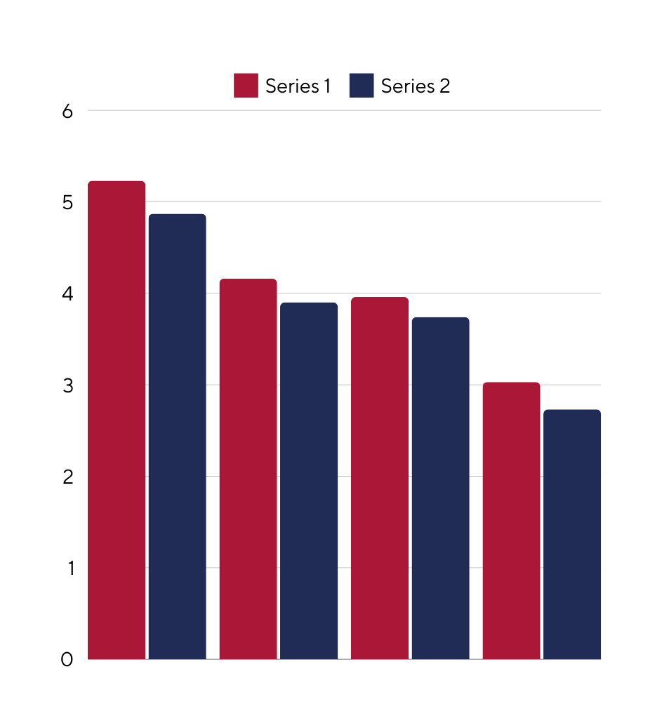
STA 2024 RESULTS BY READING
Average Grade
Consistency is Key!
17
16
15
14
13
12
11
10
Reading age

Slide 23
PASTORAL SUPPORT

Slide 24
STA YEAR 8 TEAM
AGENDA
Year 8 SLT Links
Miss F McMahon HOY
Year 8 Form Tutors
Mrs A Harris
Mr P Giblin
8A
8B
8C
8M
8W
Mr K Speake -
Assistant Headteacher -DSL
Mr A Campbell- Headteacher
Mrs J Craig / Mr R Grant
Mrs L James
Ms R Lomas
Ms M Nadeem
Mrs C Eaton

Slide 25
BEHAVIOUR SYSTEMS
At St. Antony's, we have established clear guidelines that outline our classroom and school-wide expectations. Below is a detailed overview of how we administer consequences at our institution.

Slide 26
REWARDS
AGENDA
Autumn Term - Cinema Trip - Thursday 12th December 2024
Spring Term - Playfactore - Thursday 27th March 2025
Summer Term- Blackpool Pleasure Beach - Thursday 10th July 2025

Slide 27
KEY DATES
•SEND coffee morning – 9th October 2024
•Parent Forum meeting – 22nd October 2024, 6th February 2025 & 25th June 2025
•Y8 Parent/Carer Evening – 3rd April 2025
•Y8 data drops and reporting – December, April and July (written report)

